Slide 1
MedAI HMI Presentation
Presented by Phuc Hoang, Dinh Thuan, Adina

Slide 2



Team Members
Nguyen Dinh Thuan
20210827
Adina Waidhas
2024T0035
Nguyen Duc Phuc Hoang
20210385

Slide 3
Table of contents
01
02
04
05
Introduction
Need finding
03
Concept video
Low-fi Prototype
Mid-fi Prototype

Slide 4
01
Introduction

Slide 5
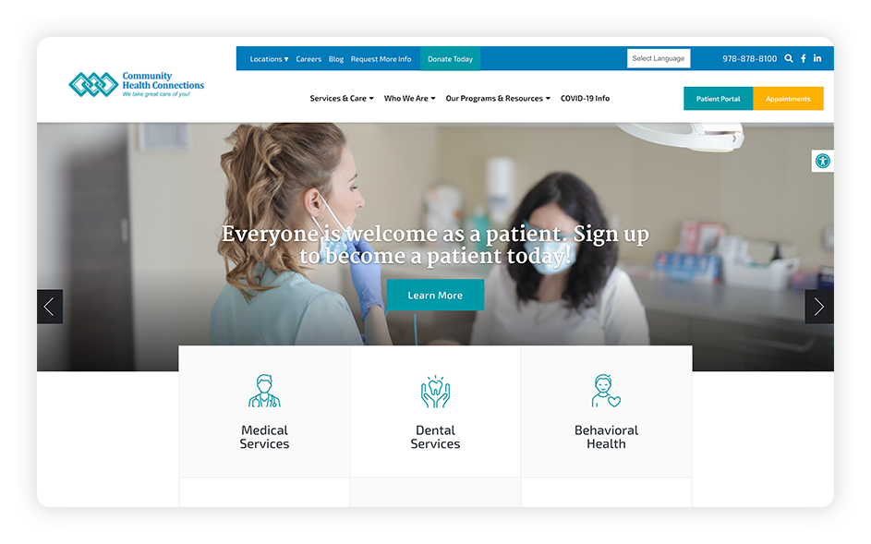
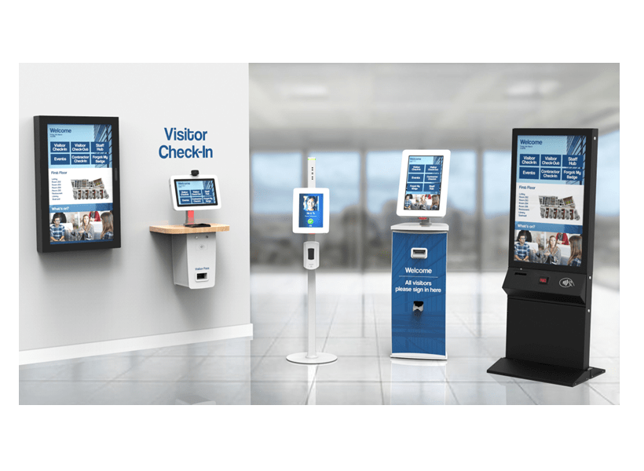
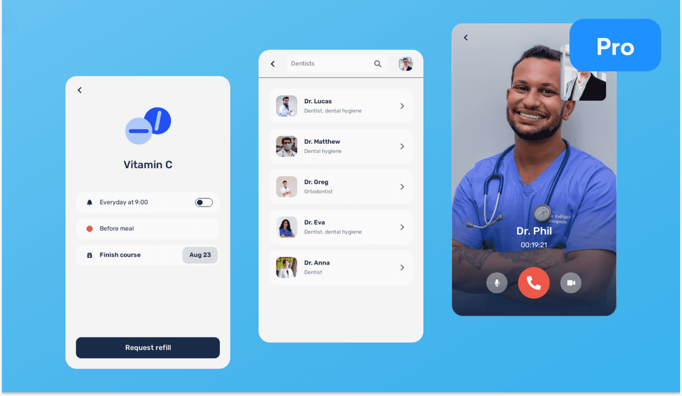
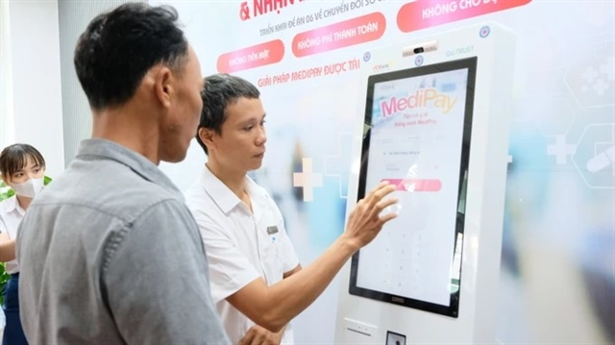
Medical Field in modern days

Slide 6
Problems
Reluctant to seek medical help
Difficulty Navigating Healthcare Systems
Lack of awareness
Many individuals avoid visiting doctors due to fear, lack of time, or inconvenience in accessing healthcare services.
People often fail to recognize early warning signs of illnesses or rely on unreliable sources for medical advice.
Patients struggle to find the right doctor or facility and face challenges understanding complex processes.

Slide 7

Introducing: MedAI

Slide 8
02
Need Finding

Slide 9
Problem Domain
Investigate medical Website Usability, including navigation, scheduling, information, chatbot
Investigate user experiences on medical websites to identify pain points and improvement
Focus on how different user groups interact with the platform

Slide 10
Needfinding Methodology
Who?
- Normal user: Individual with typical experience with medical website
- Expert user: Medical professional
- Extreme user: Inexperienced older people
Why? Goal: To gather insights on how different user types interact with medical websites.
When? Schedule at times convenient for the participants, each interview lasts 10-20 min
Where?
- Online: Teams, Discord
- Face to face
How?
- 15-20 minutes interview
- Questionaire for more structured data

Slide 11
Interview Questions
What is your overall experience using medical websites?
How often do you visit medical websites, and what motivates your visit?
What frustrates you the most when using medical websites?
What improvements would you like to see on medical websites?
How do you feel about interacting with chatbots or automated systems on medical websites?
Have you ever had to contact customer support while using a medical website?
Have you ever had a security or privacy concern when using a medical website?
How often do you rely on medical websites versus calling the healthcare provider directly?
Do you prefer using apps over websites for managing your health information?
How do you navigate these websites on mobile versus desktop devices?

Slide 12
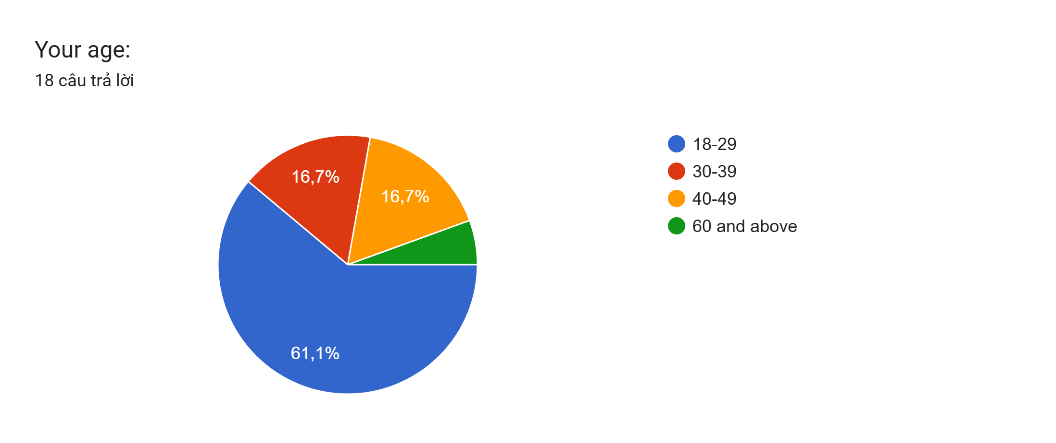
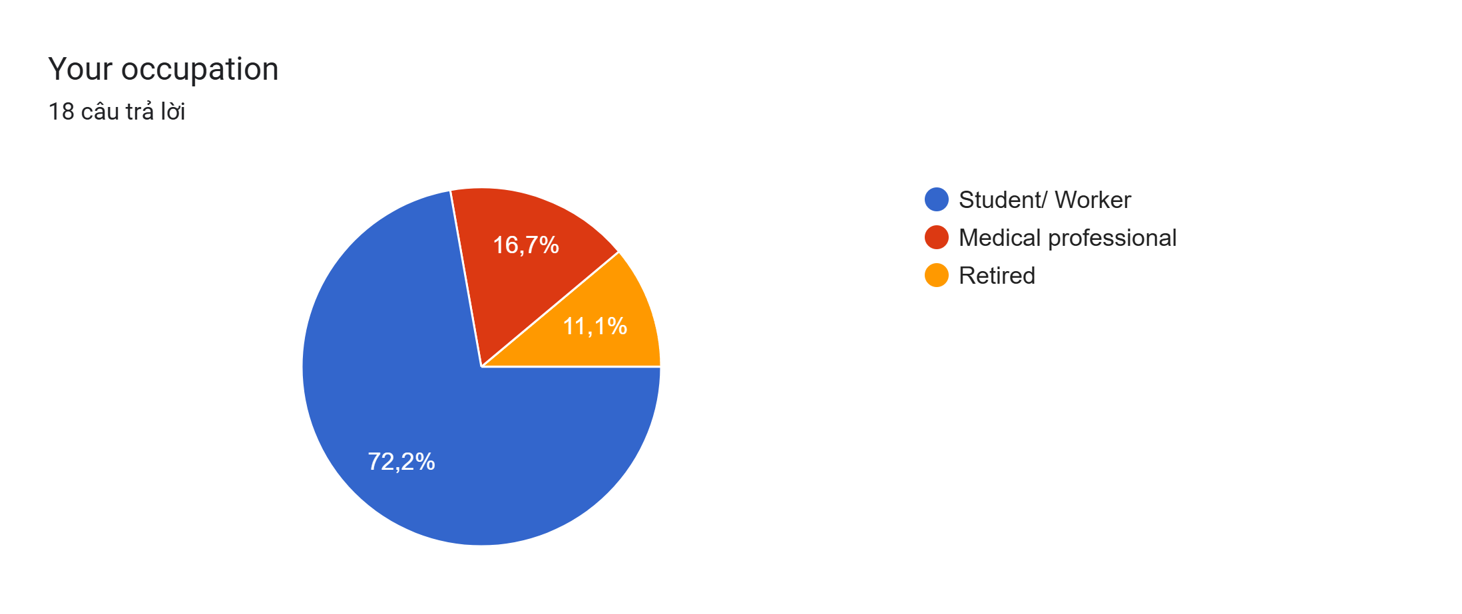
Observation results
Interview: We interviewed 5 people:
Common users: Thanh (21, Student), Nghia (17, Student), Roman (32, Worker)
Extreme users: Trung (64, Retired)
Expert users: Ngan Ha (29, Specialist Doctor)
Questionaire: We received 18 responses from different user groups

Slide 13
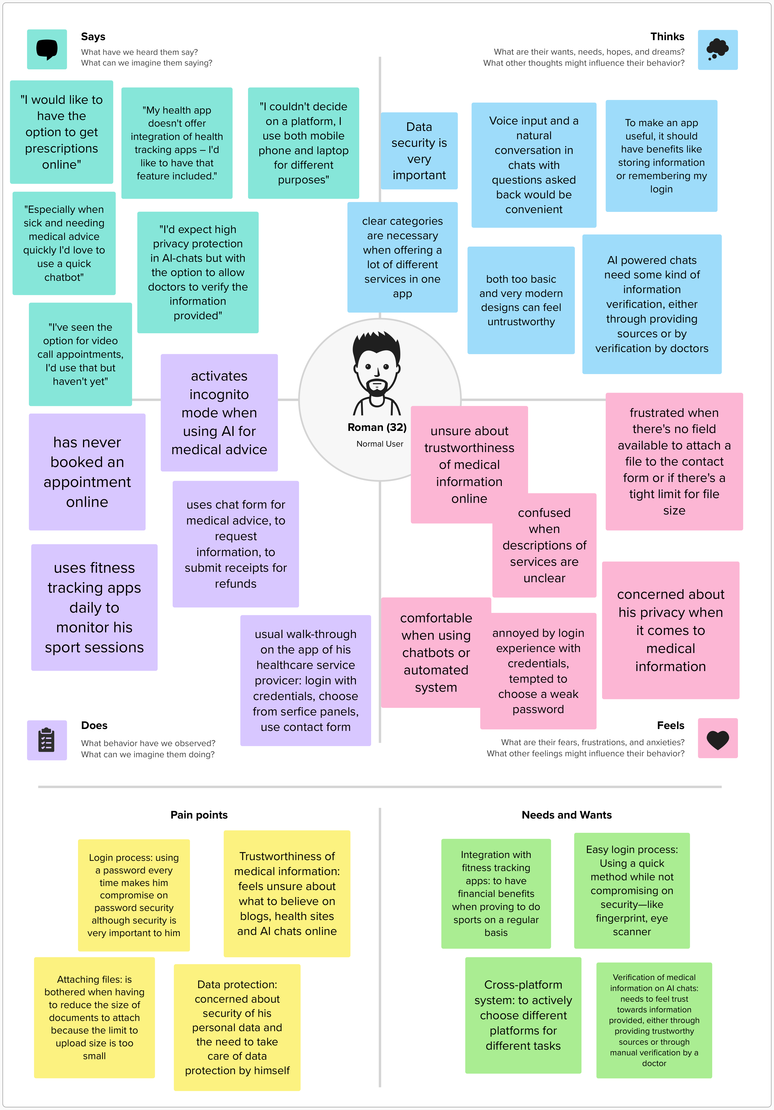
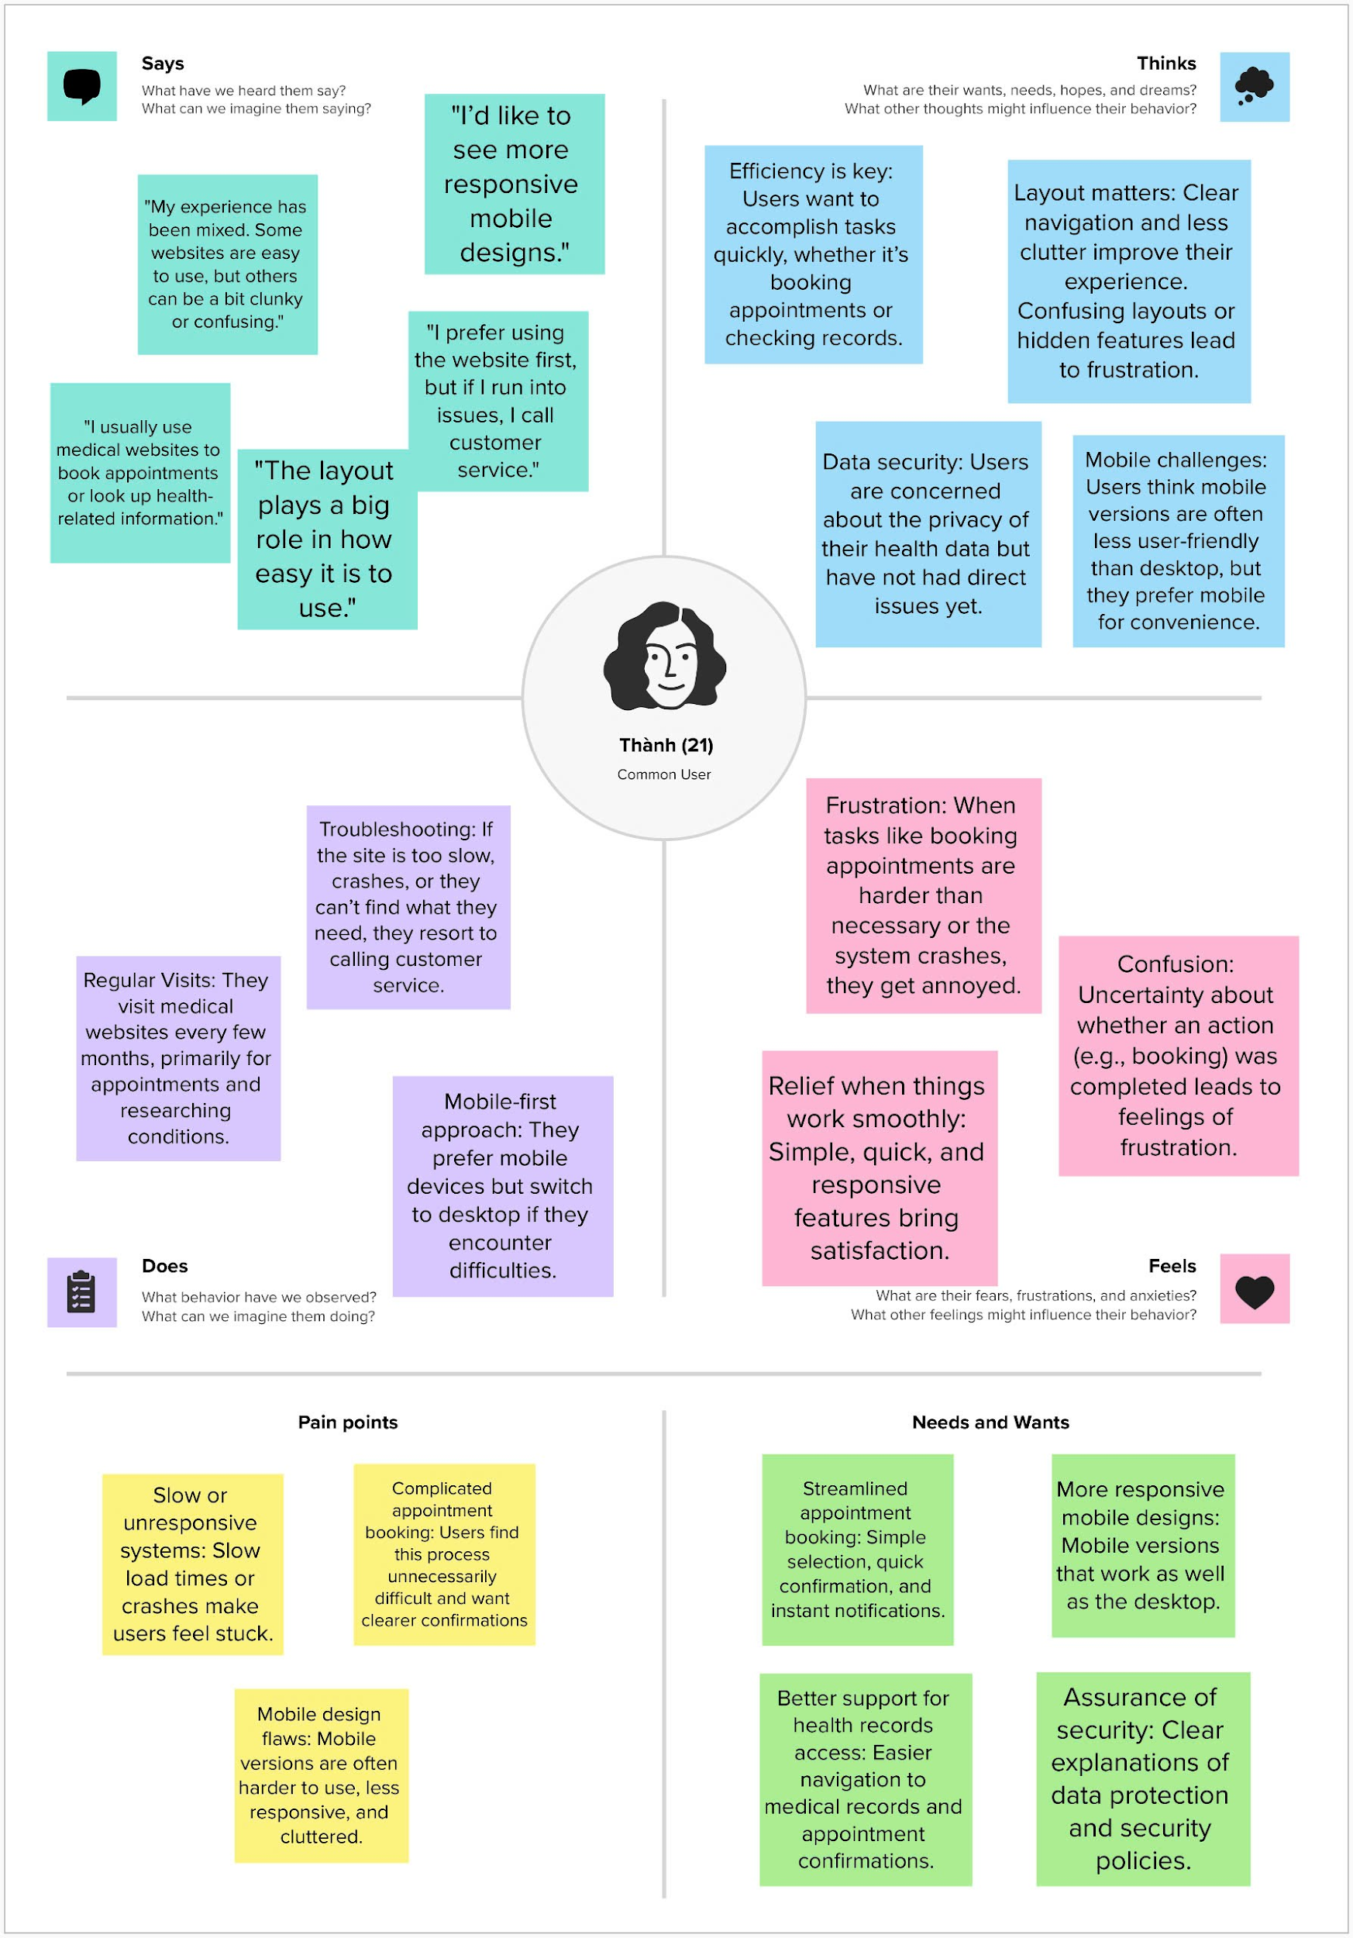
Common User Empathy Map

Slide 14
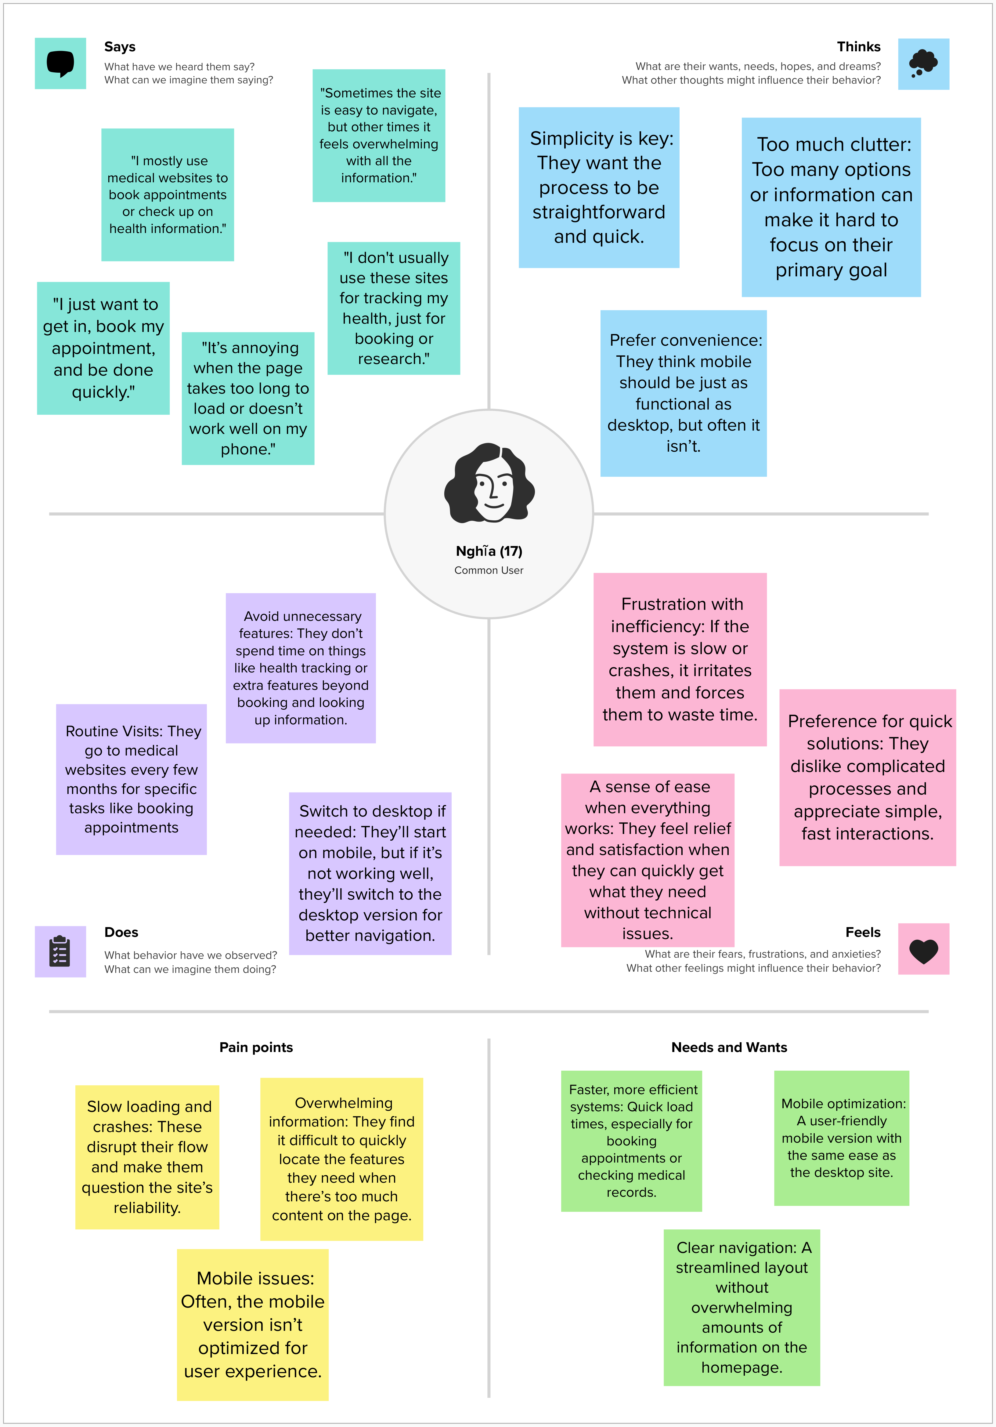
Common User Empathy Map

Slide 15
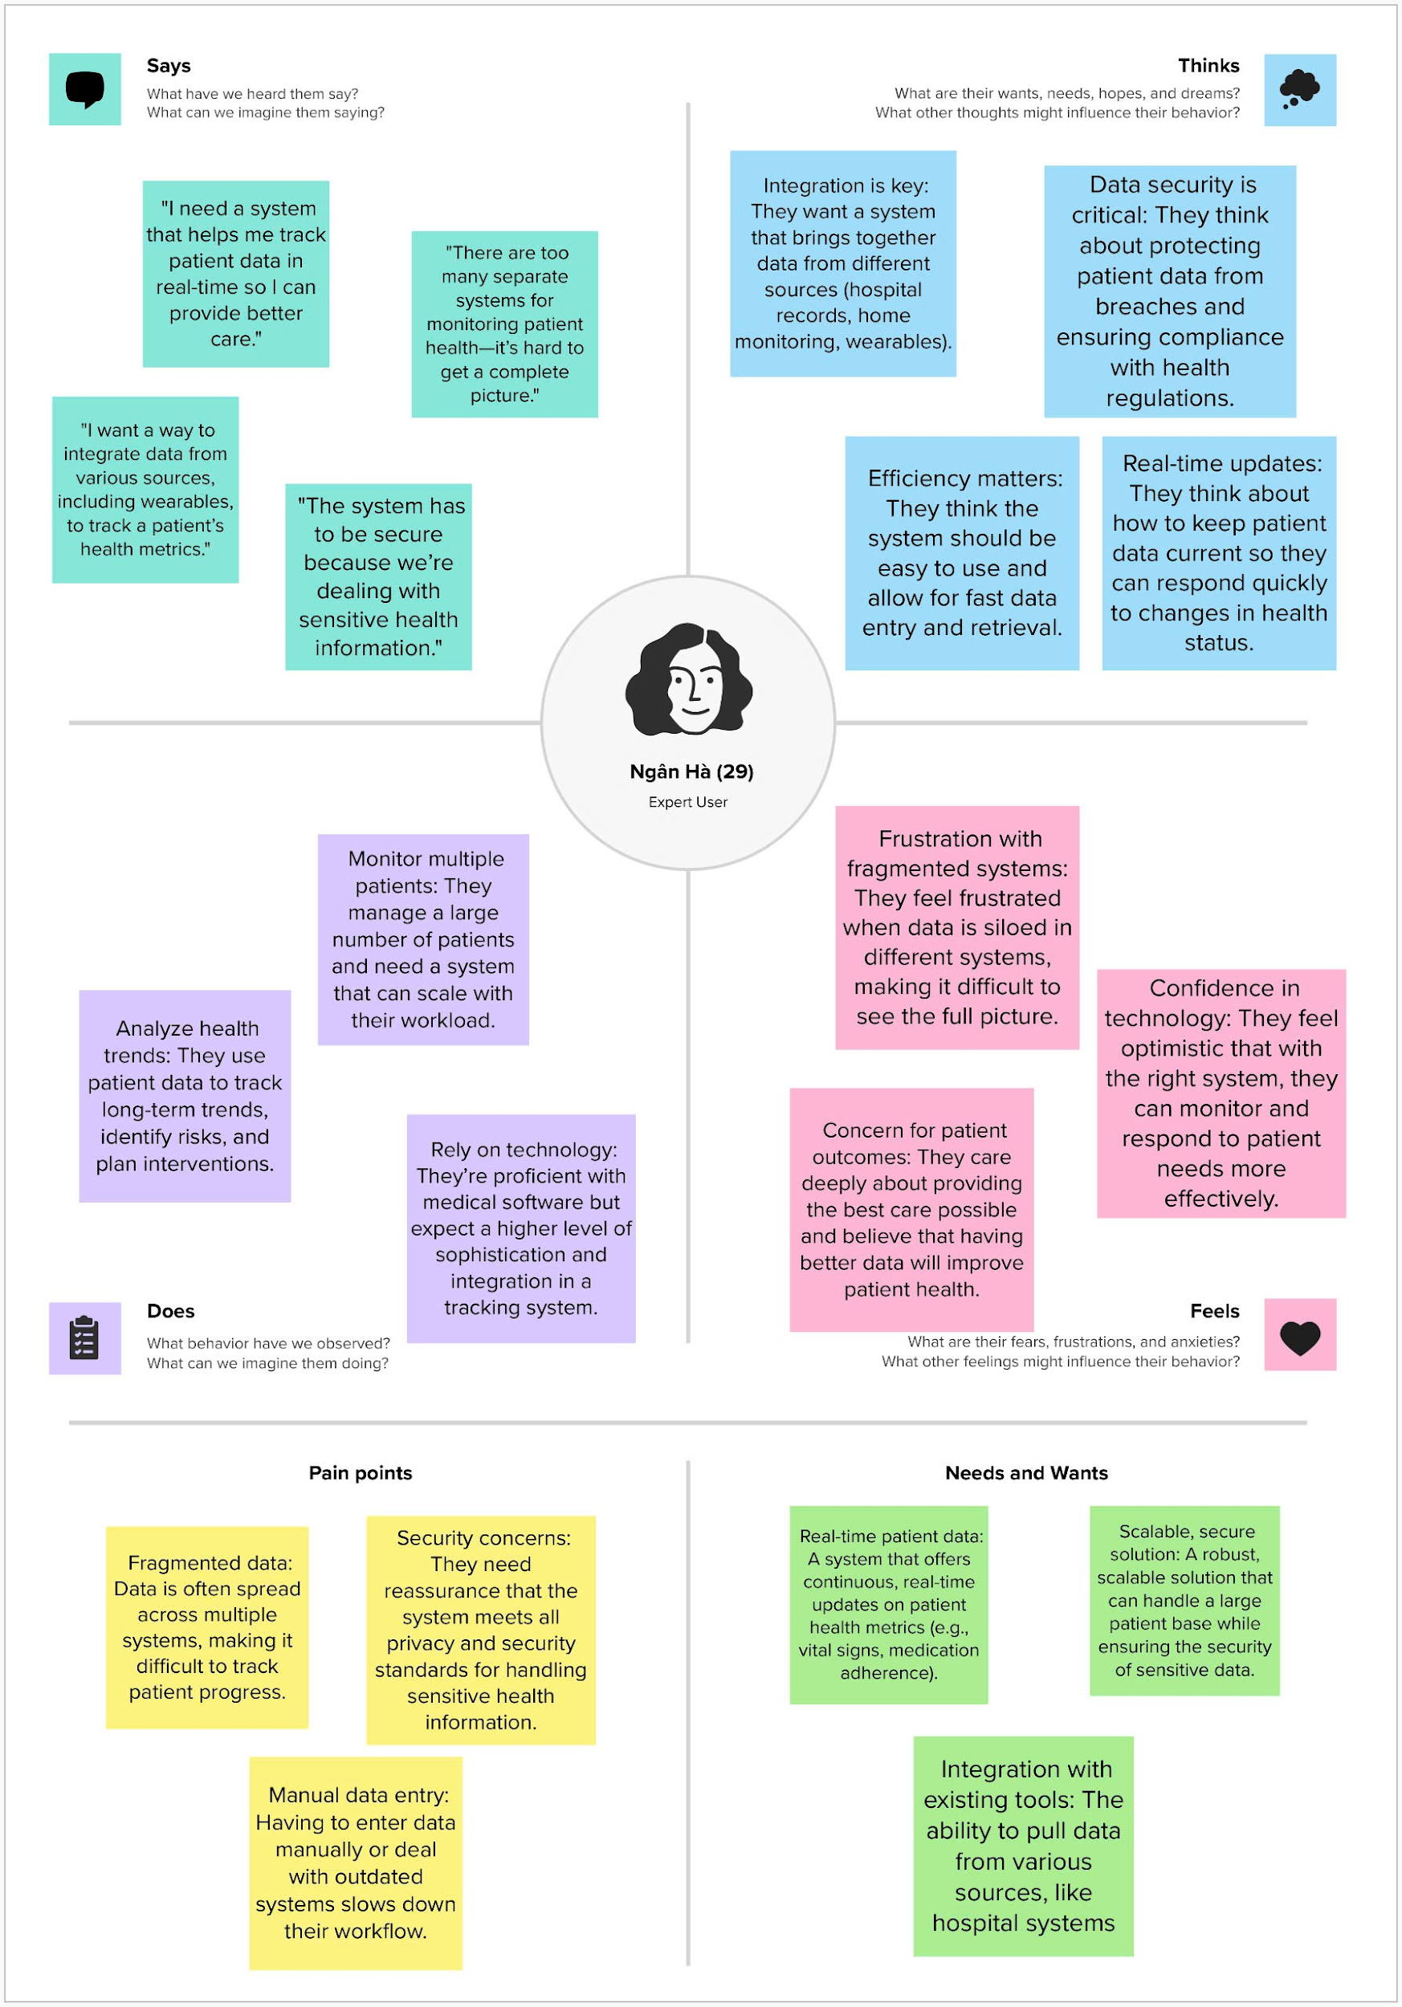
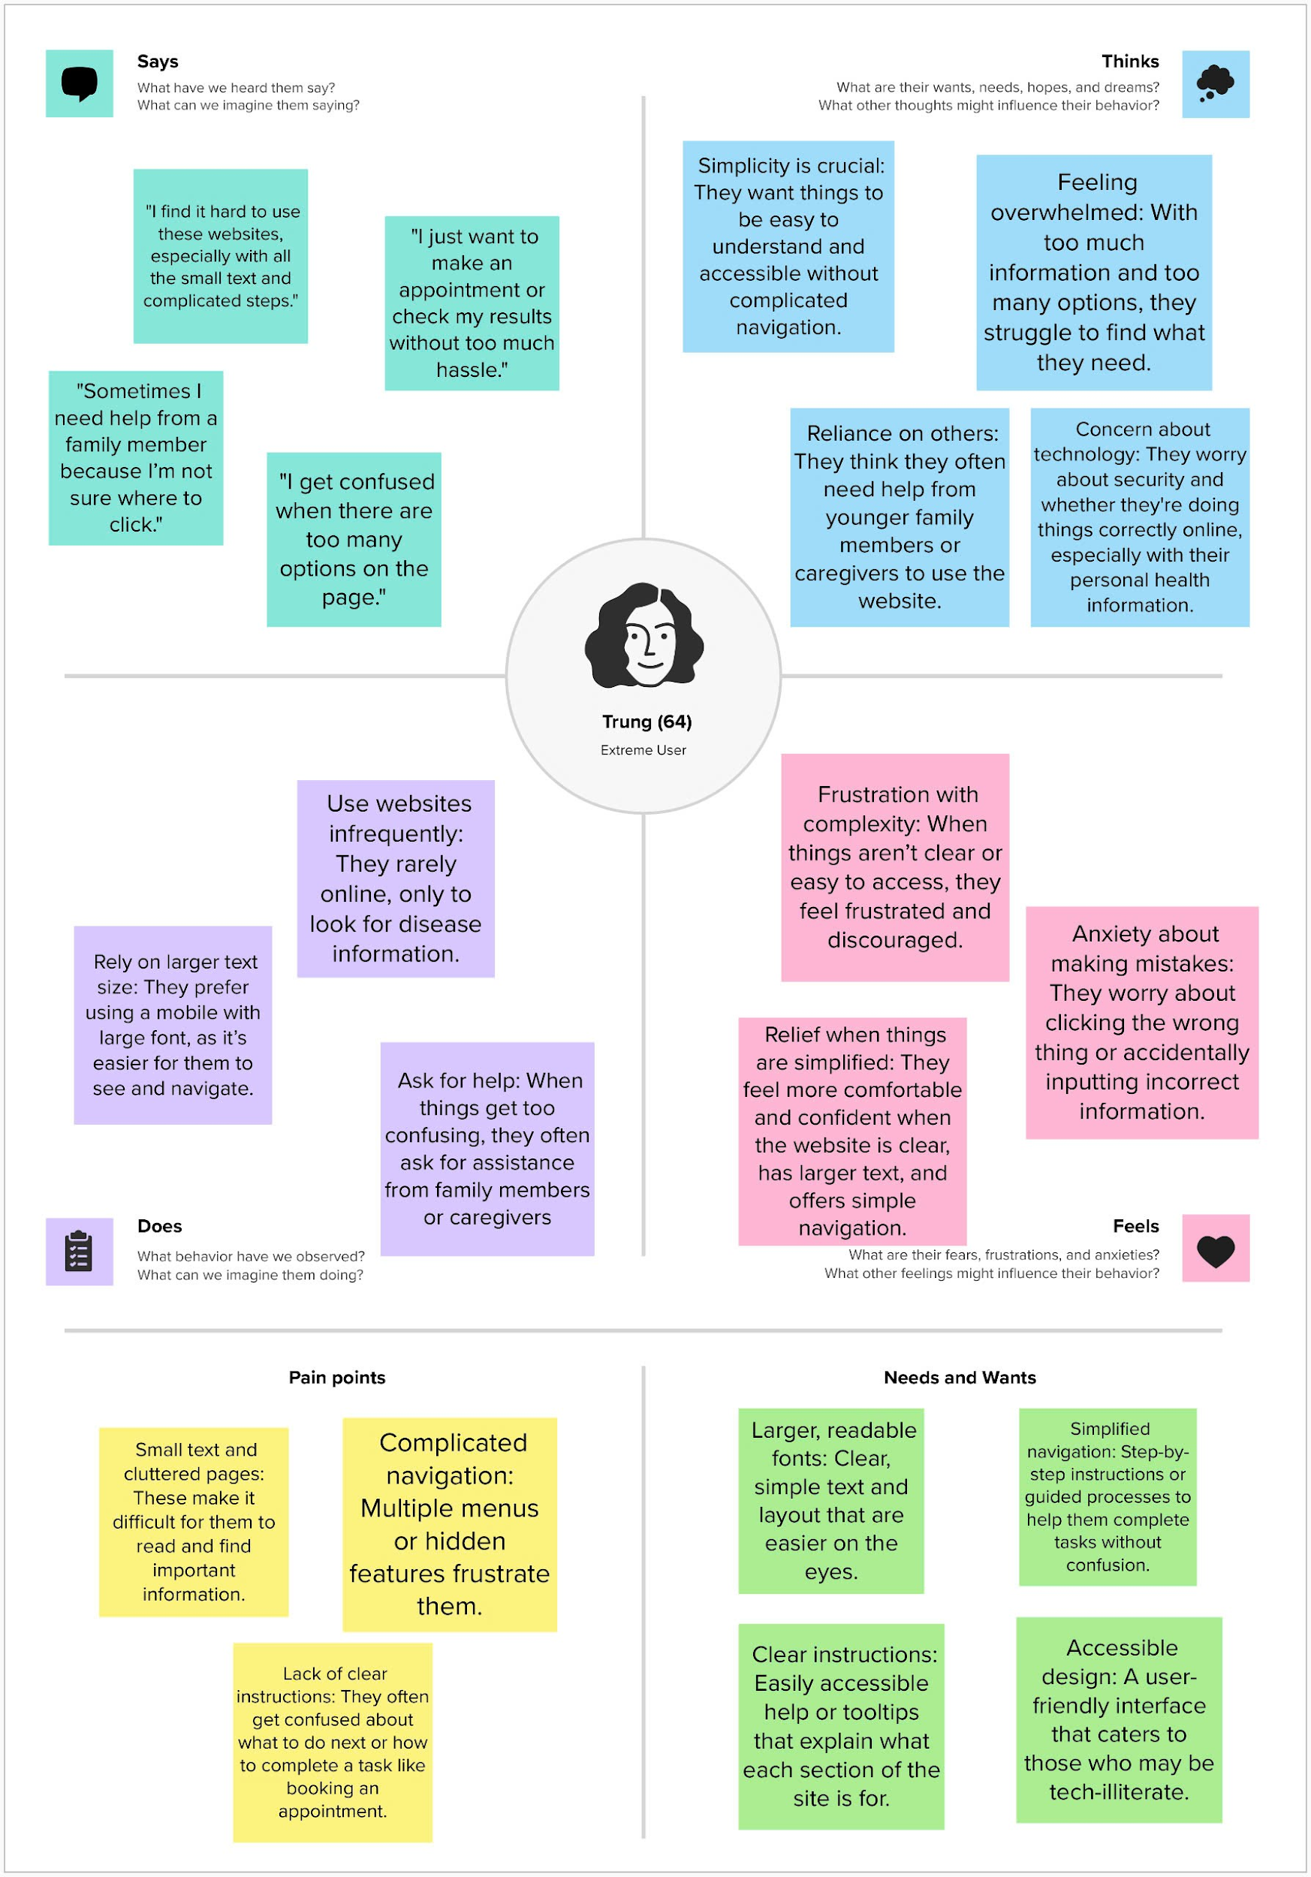
Extreme and Expert User Empathy Map

Slide 16
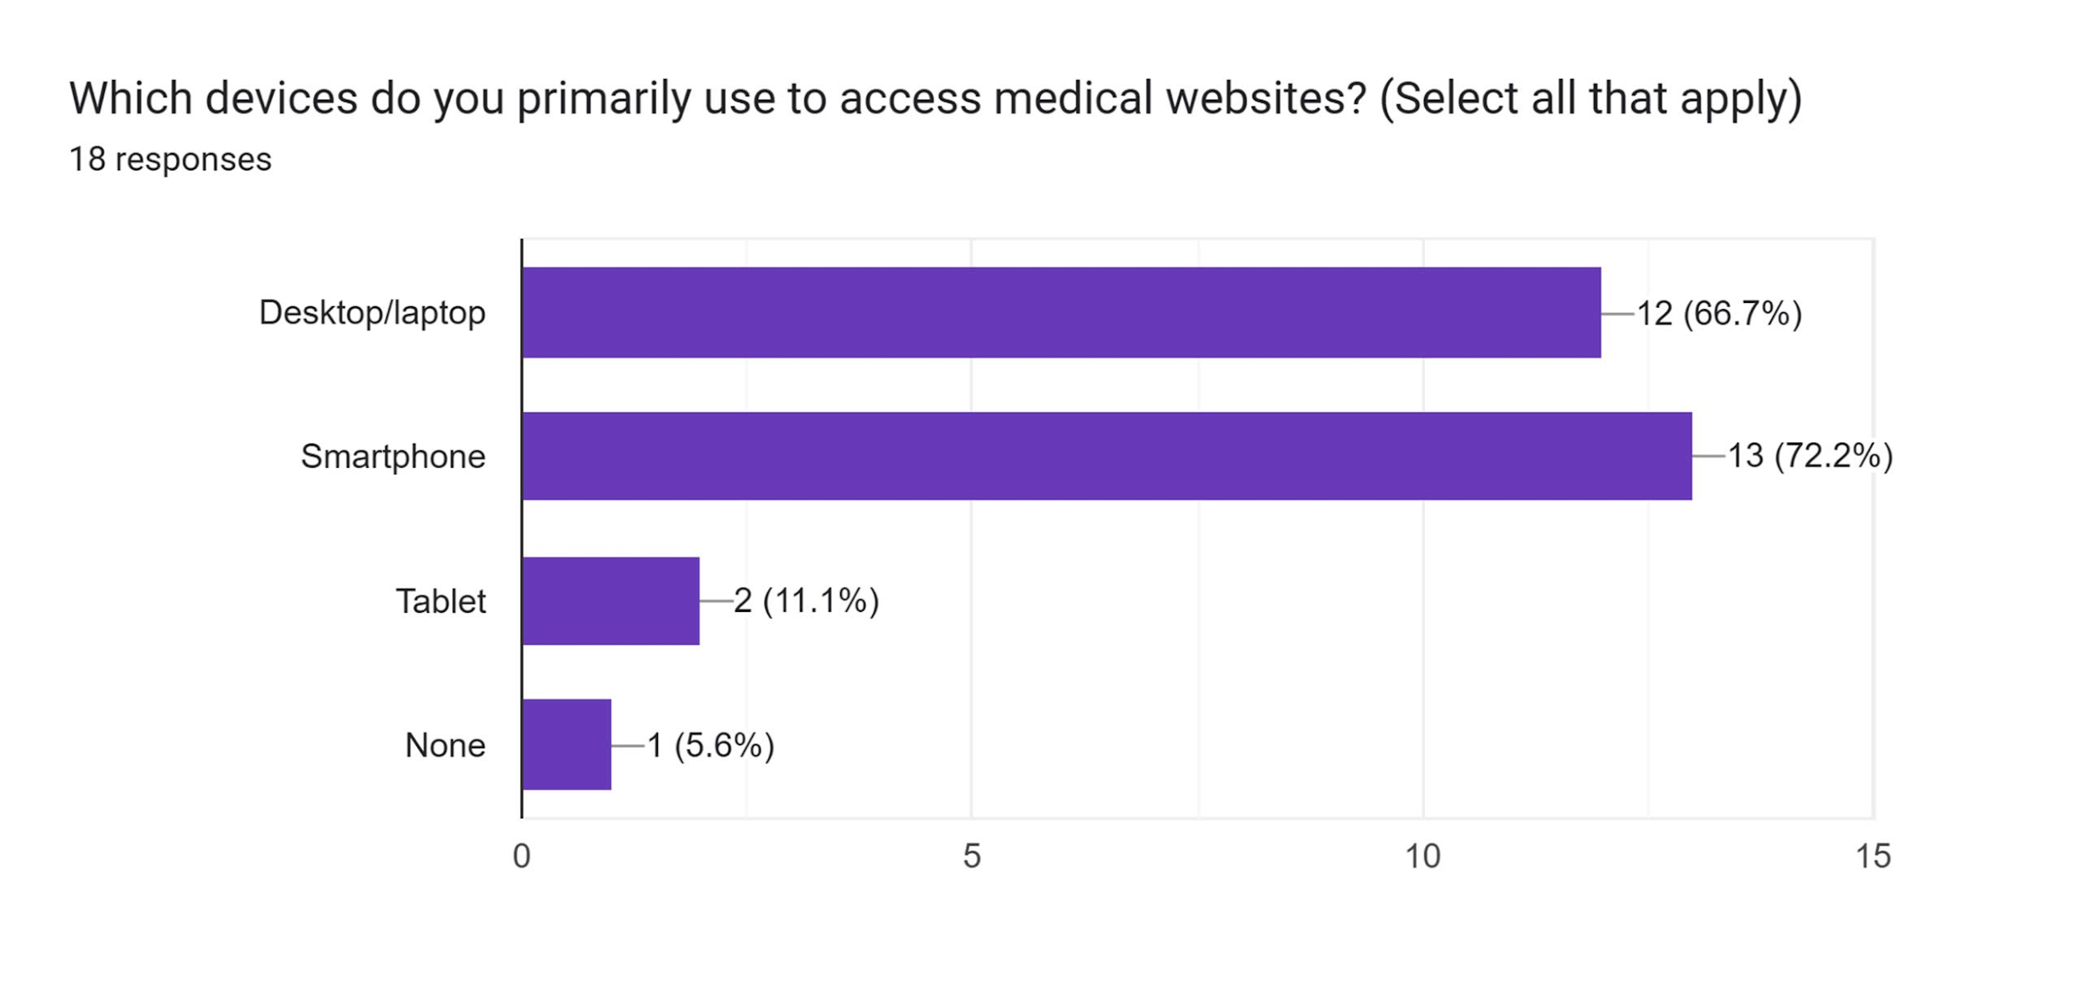
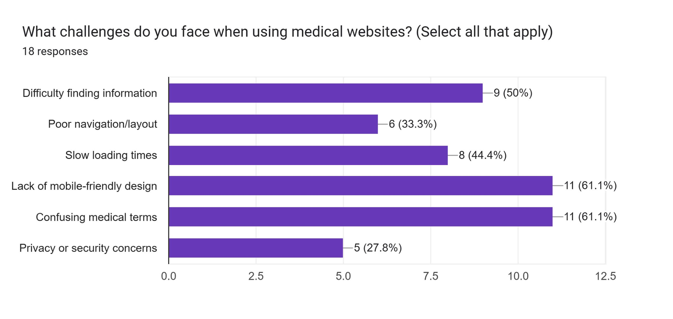
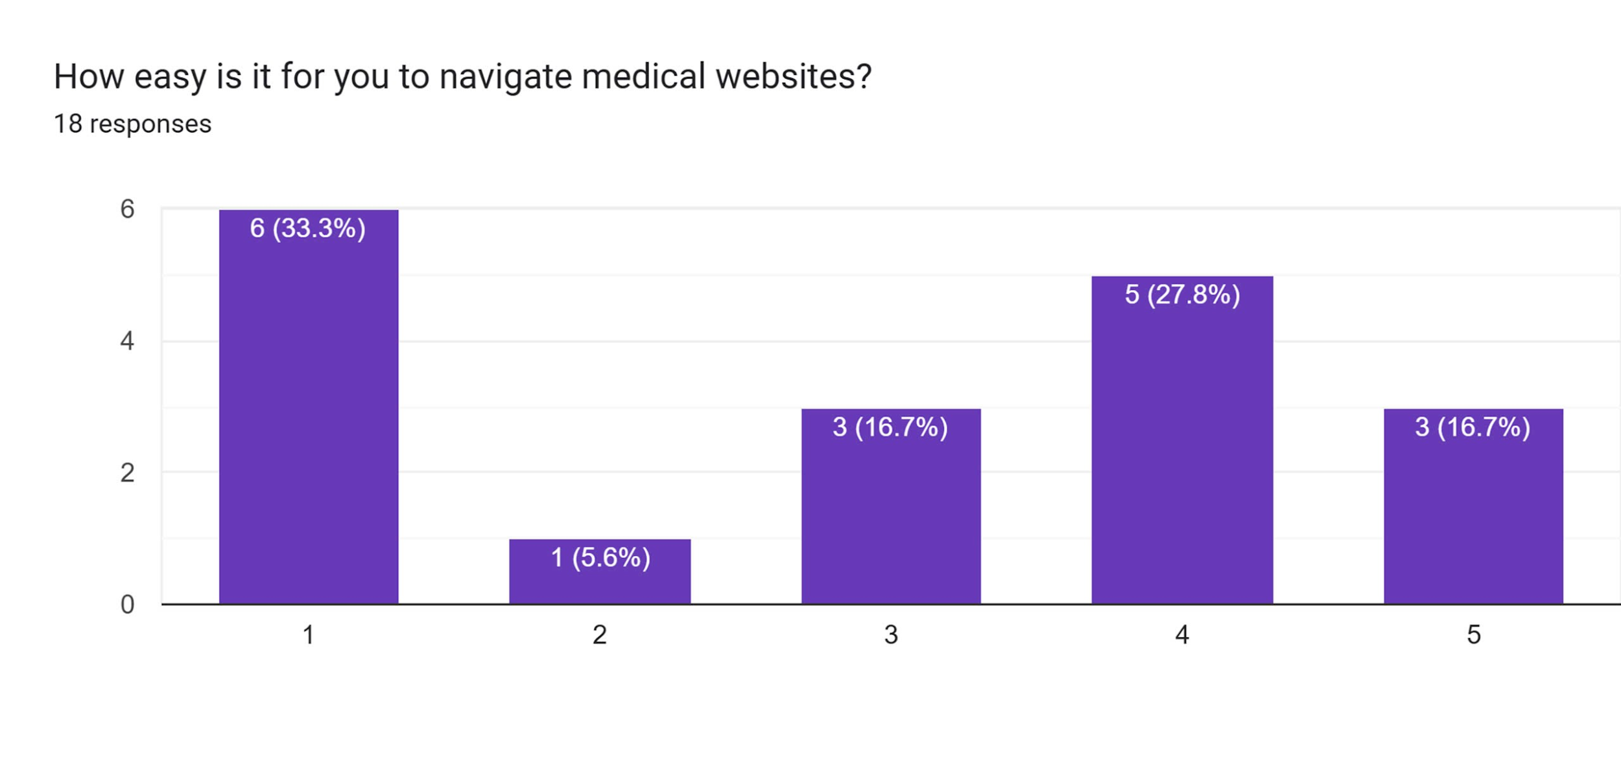
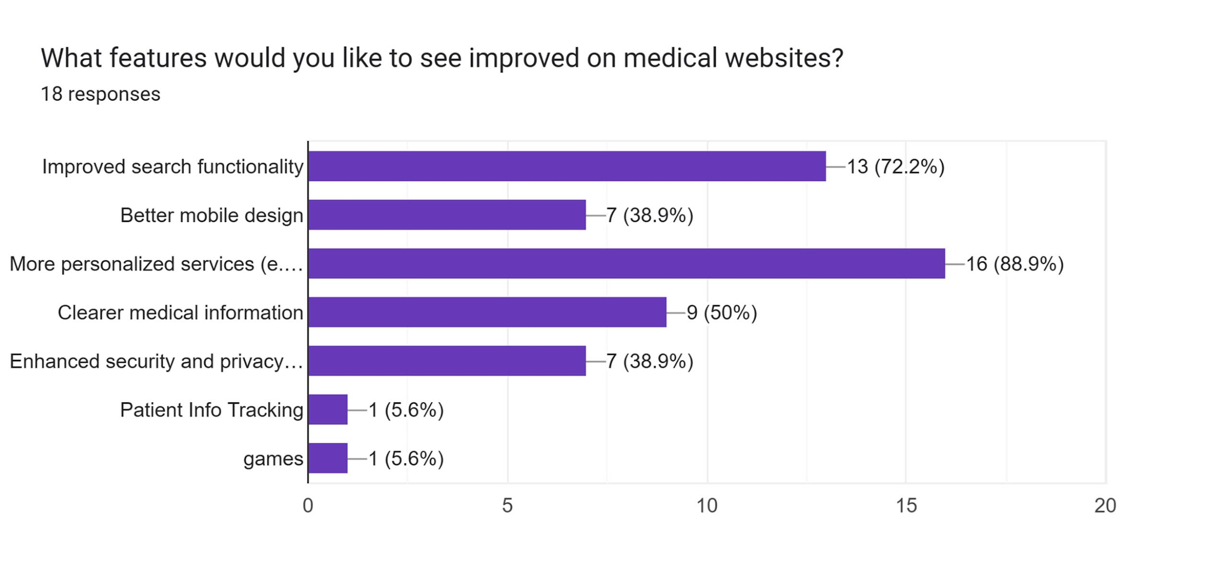
Questionaire Result

Slide 17
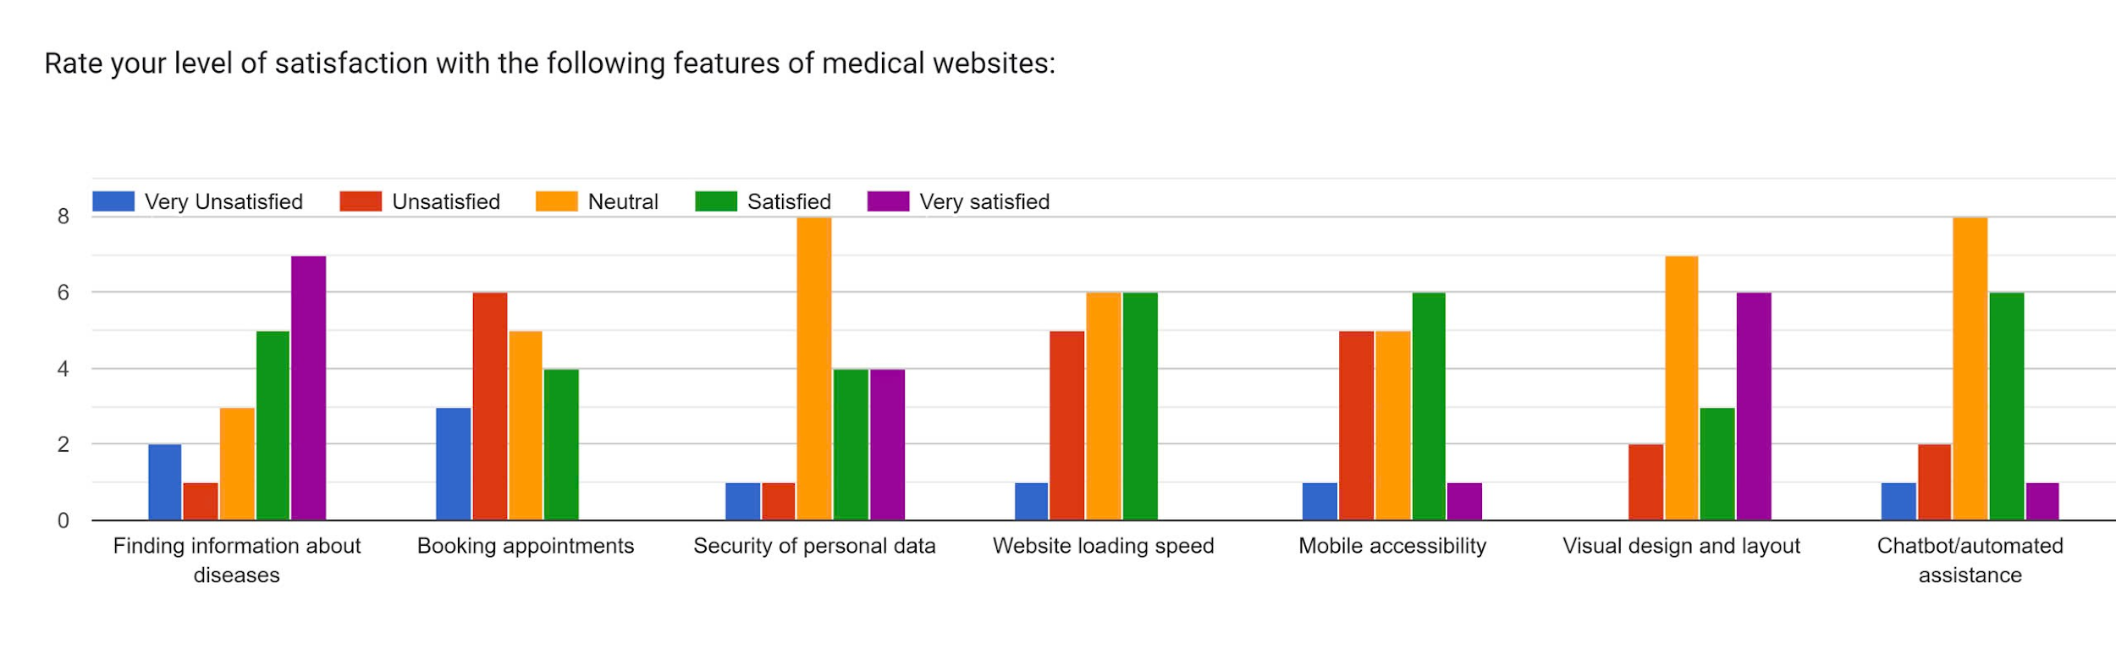
Questionaire Result

Slide 18
Needs and Insights
Needs:
Simplified user experience for older users, with larger fonts and fewer navigational layers.
Faster, more reliable appointment booking systems for general users to avoid frustration.
Better mobile optimization for all users, focusing on clear, decluttered designs.
Real-time, integrated patient tracking for medical professionals to help monitor patients across different platforms and sources.
Insights:
Users prioritize ease of access and clarity over features. Too much information leads to frustration, especially for non-tech-savvy users.
Medical professionals have distinct needs related to real-time data integration, which requires advanced systems but should not compromise simplicity for other users.
Older users rely on assistance due to poor design, and improving accessibility would enhance their independence.

Slide 19
03
Concept Video

Slide 20
Market Research
Market Needs
Market Trends
Market Opportunity
Reliable medical information as users prioritize personal health; rise in telehealth apps, especially post-pandemic, with users seeking quick, easy online medical advice.
Digital healthcare trends like AI, chatbots, and data analytics drive strong growth in telemedicine and online services, enhancing user experience.
Adding appointment reminders and medical history storage enhances user convenience. High scalability with online consultations and expansion to new areas.

Slide 21
Market Research
 | MegaMed | Vinmec | Mayo Clinic | Bach Mai Hospital | VietHeal
Free to use | V | V | V | V | V
Appointment Schedulling |  | V | V
Symptom Checker |  |  |  | V
Mobile App | V |  |  |  | V
Chatbot Support
Community Forums |  | V

Slide 22
Stakeholders
Patients
Healthcare
Provider
Admins
Researchers

Slide 23
Core values
Accessibility: Ensure that healthcare information and services are easy to access for everyone.
Trust: Provide accurate, reliable, and verified medical information to build user confidence.
Empowerment: Enable users to make informed healthcare decisions through knowledge and tools.
Inclusivity: Design the platform to cater to diverse demographics and needs.
Privacy: Uphold the highest standards of data protection and confidentiality.

Slide 24
Tasks
Simple: Login/ Signup
Moderate: Chatbot
Complex: Booking

Slide 25

Concept video

Slide 26
04
Low-fidelity Prototype

Slide 27
Concept sketches

Slide 28
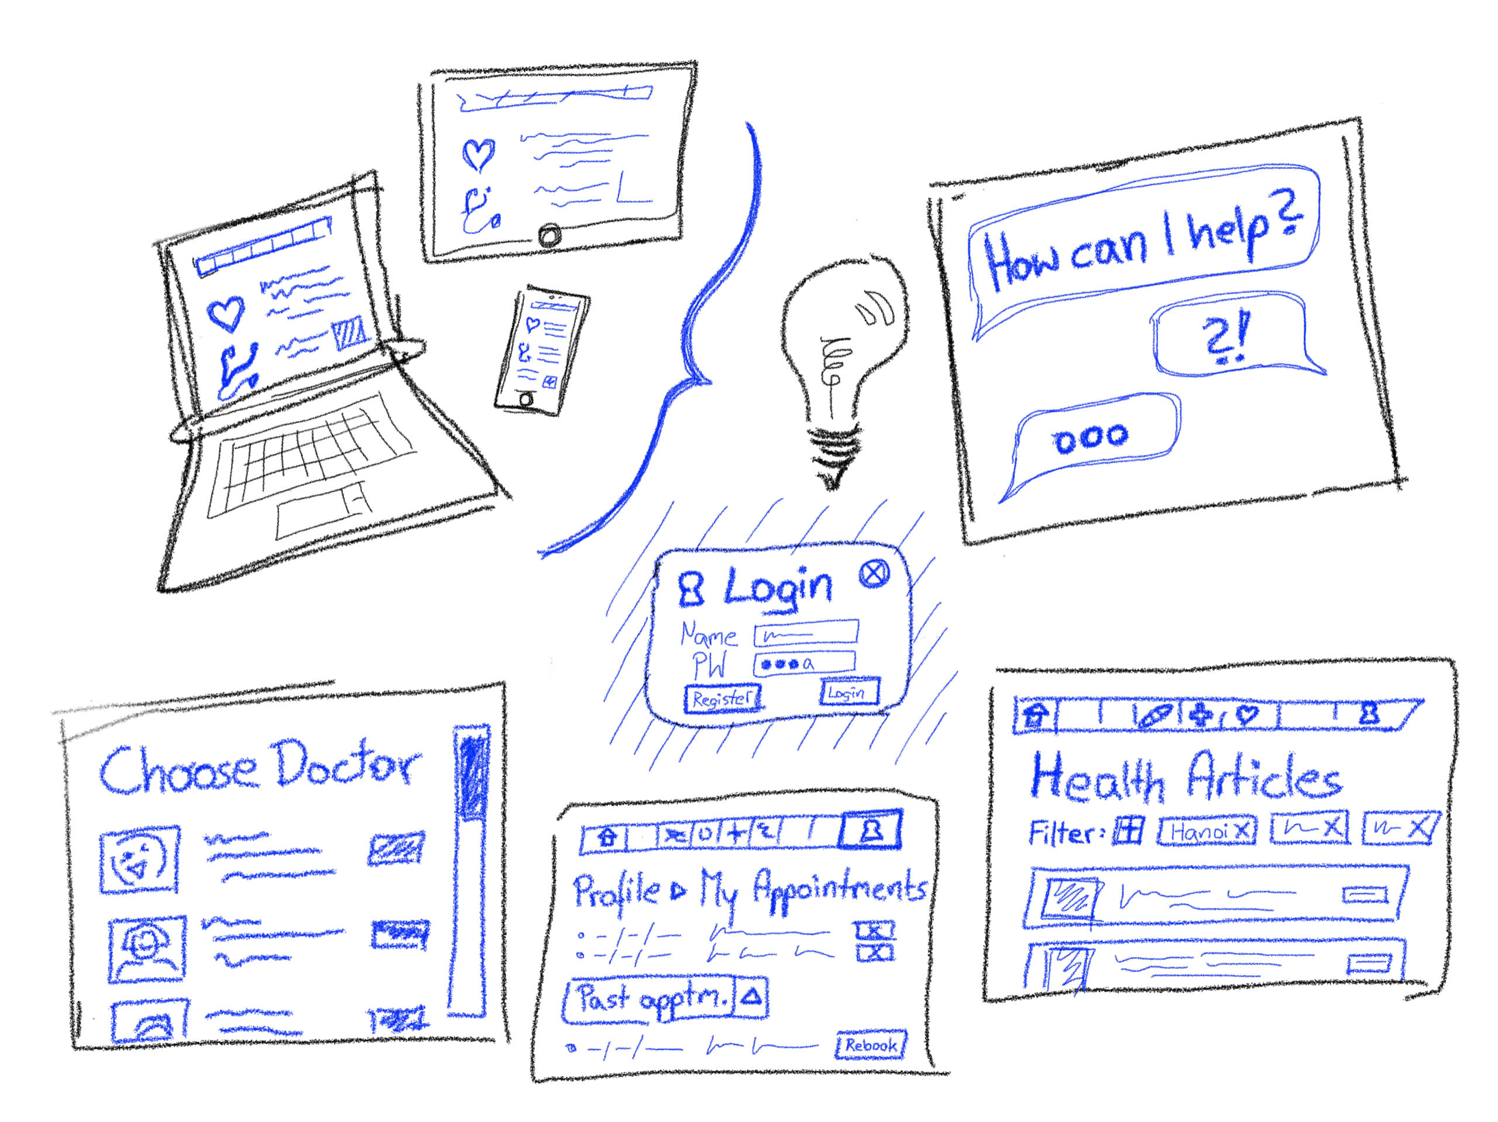
Concept 1: Website

Slide 29
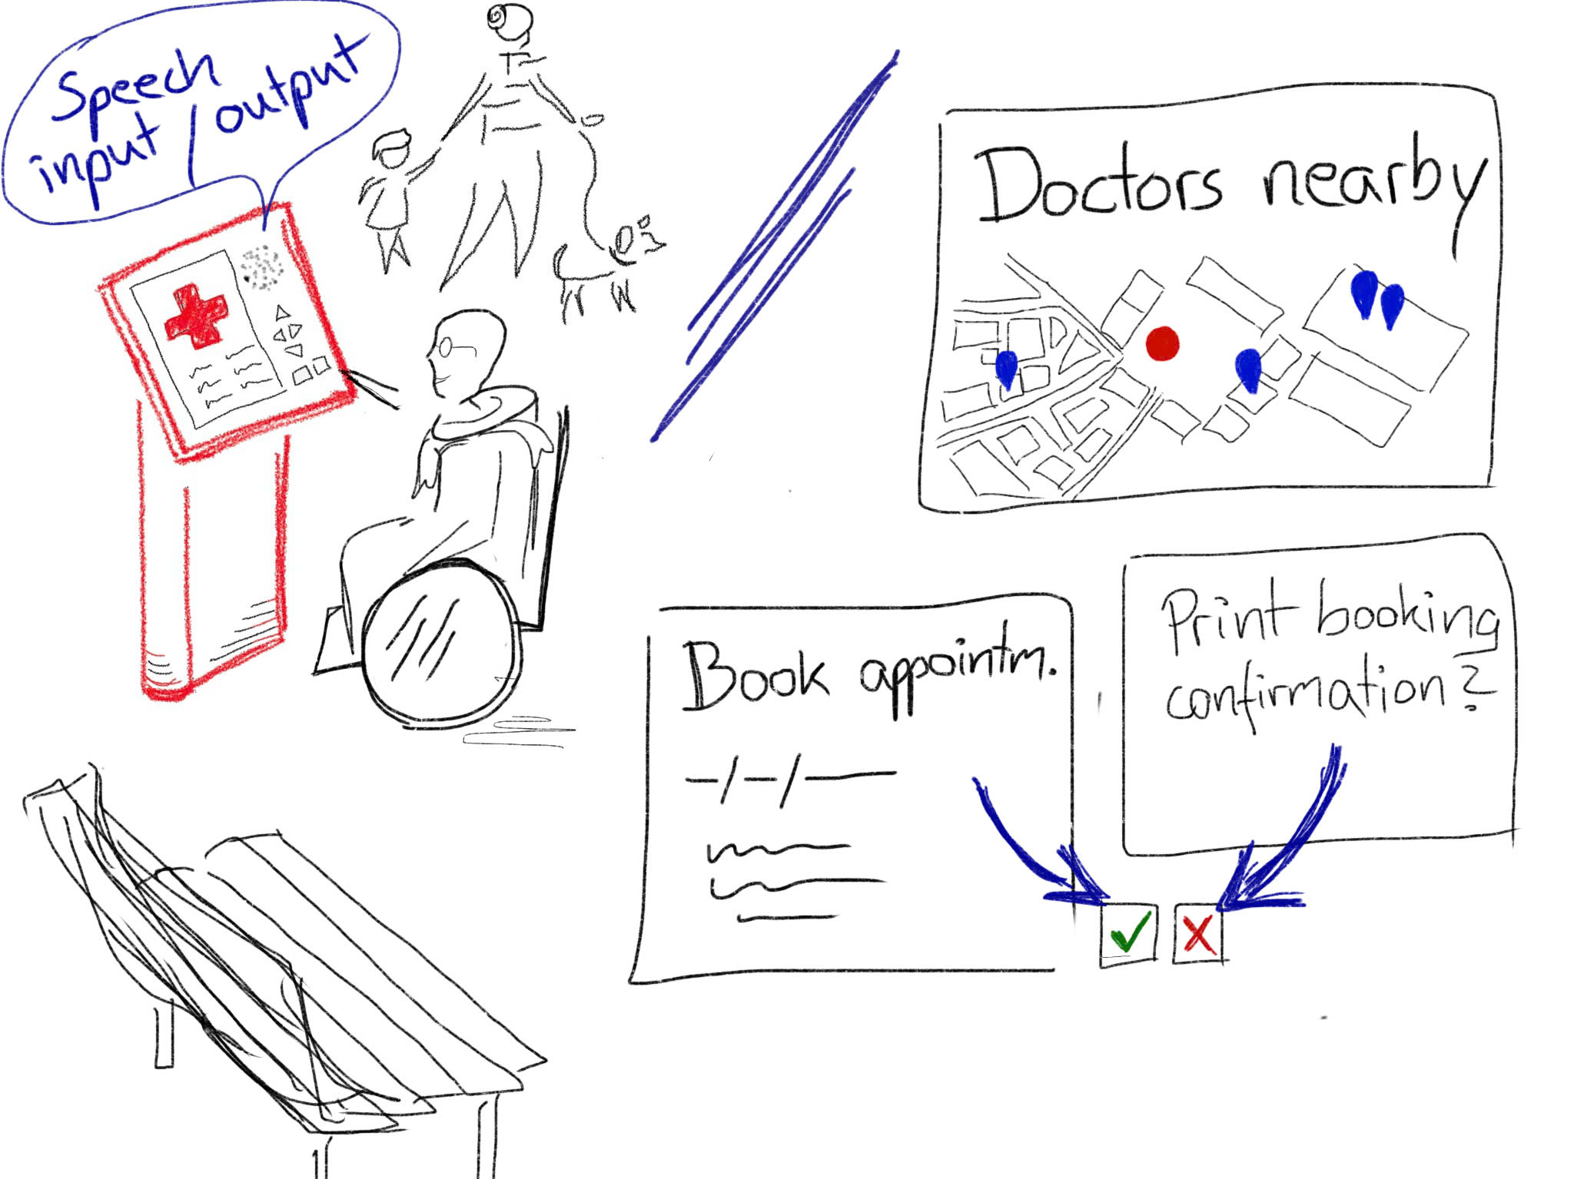
Concept 2: Public Kiosk

Slide 30
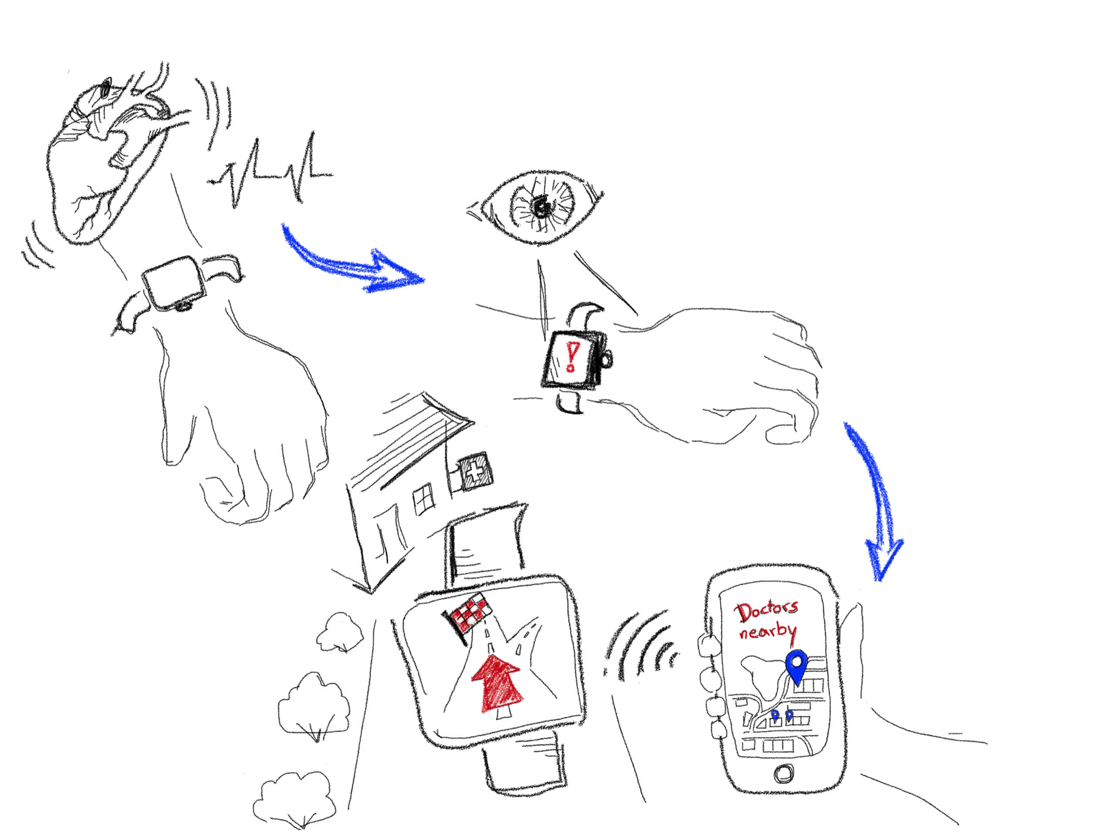
Concept 3: Interactive Wearables

Slide 31
Selected Interface: Website
While wearables offer real-time health tracking, their high cost, limited accessibility, and small interface make them less practical. A medical website is far more accessible, scalable, and user-friendly, reaching a wider audience with lower costs. It can host comprehensive features like appointment scheduling and health information, meeting diverse needs without requiring specialized devices.
Websites leverage the ubiquity of internet-connected devices, ensuring broad adoption and delivering impactful healthcare solutions.

Slide 32
3 task flows
Moderate
Simple
Complex

Slide 33
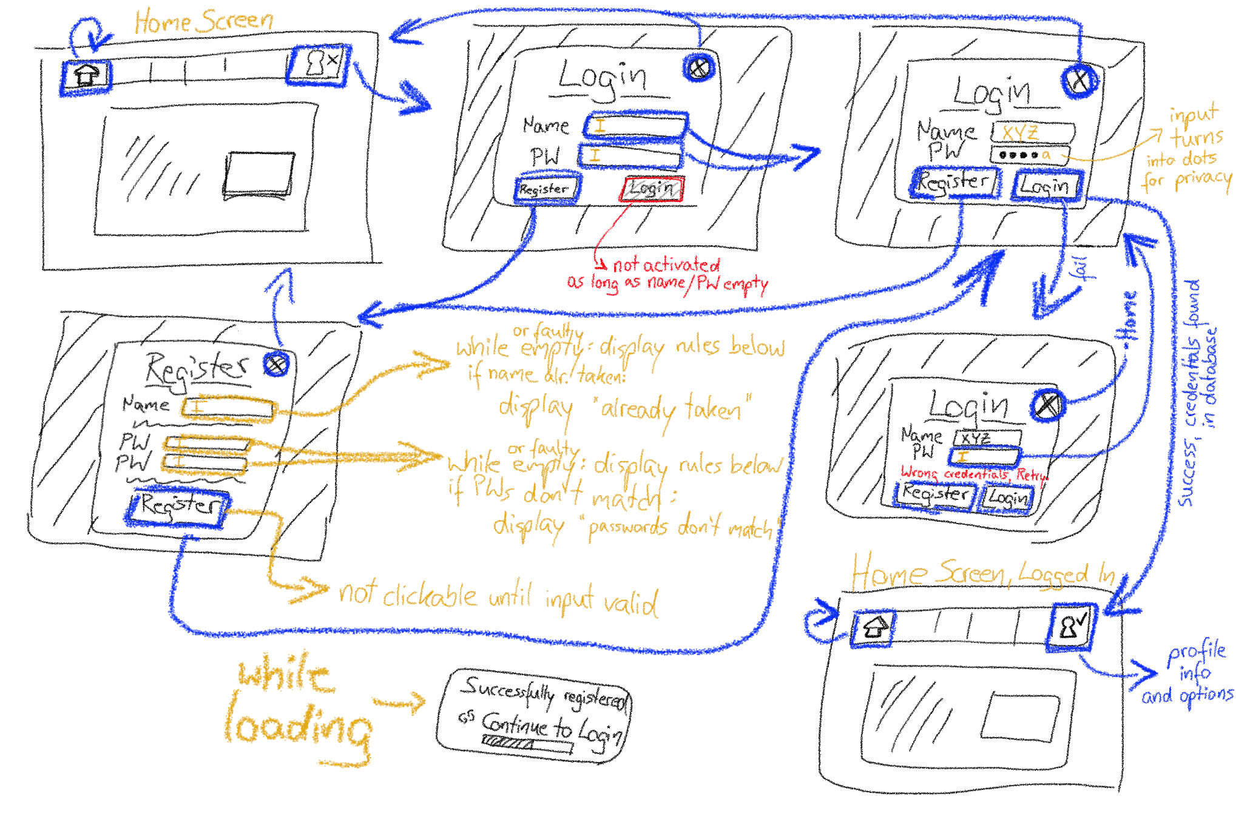
Simple

Slide 34
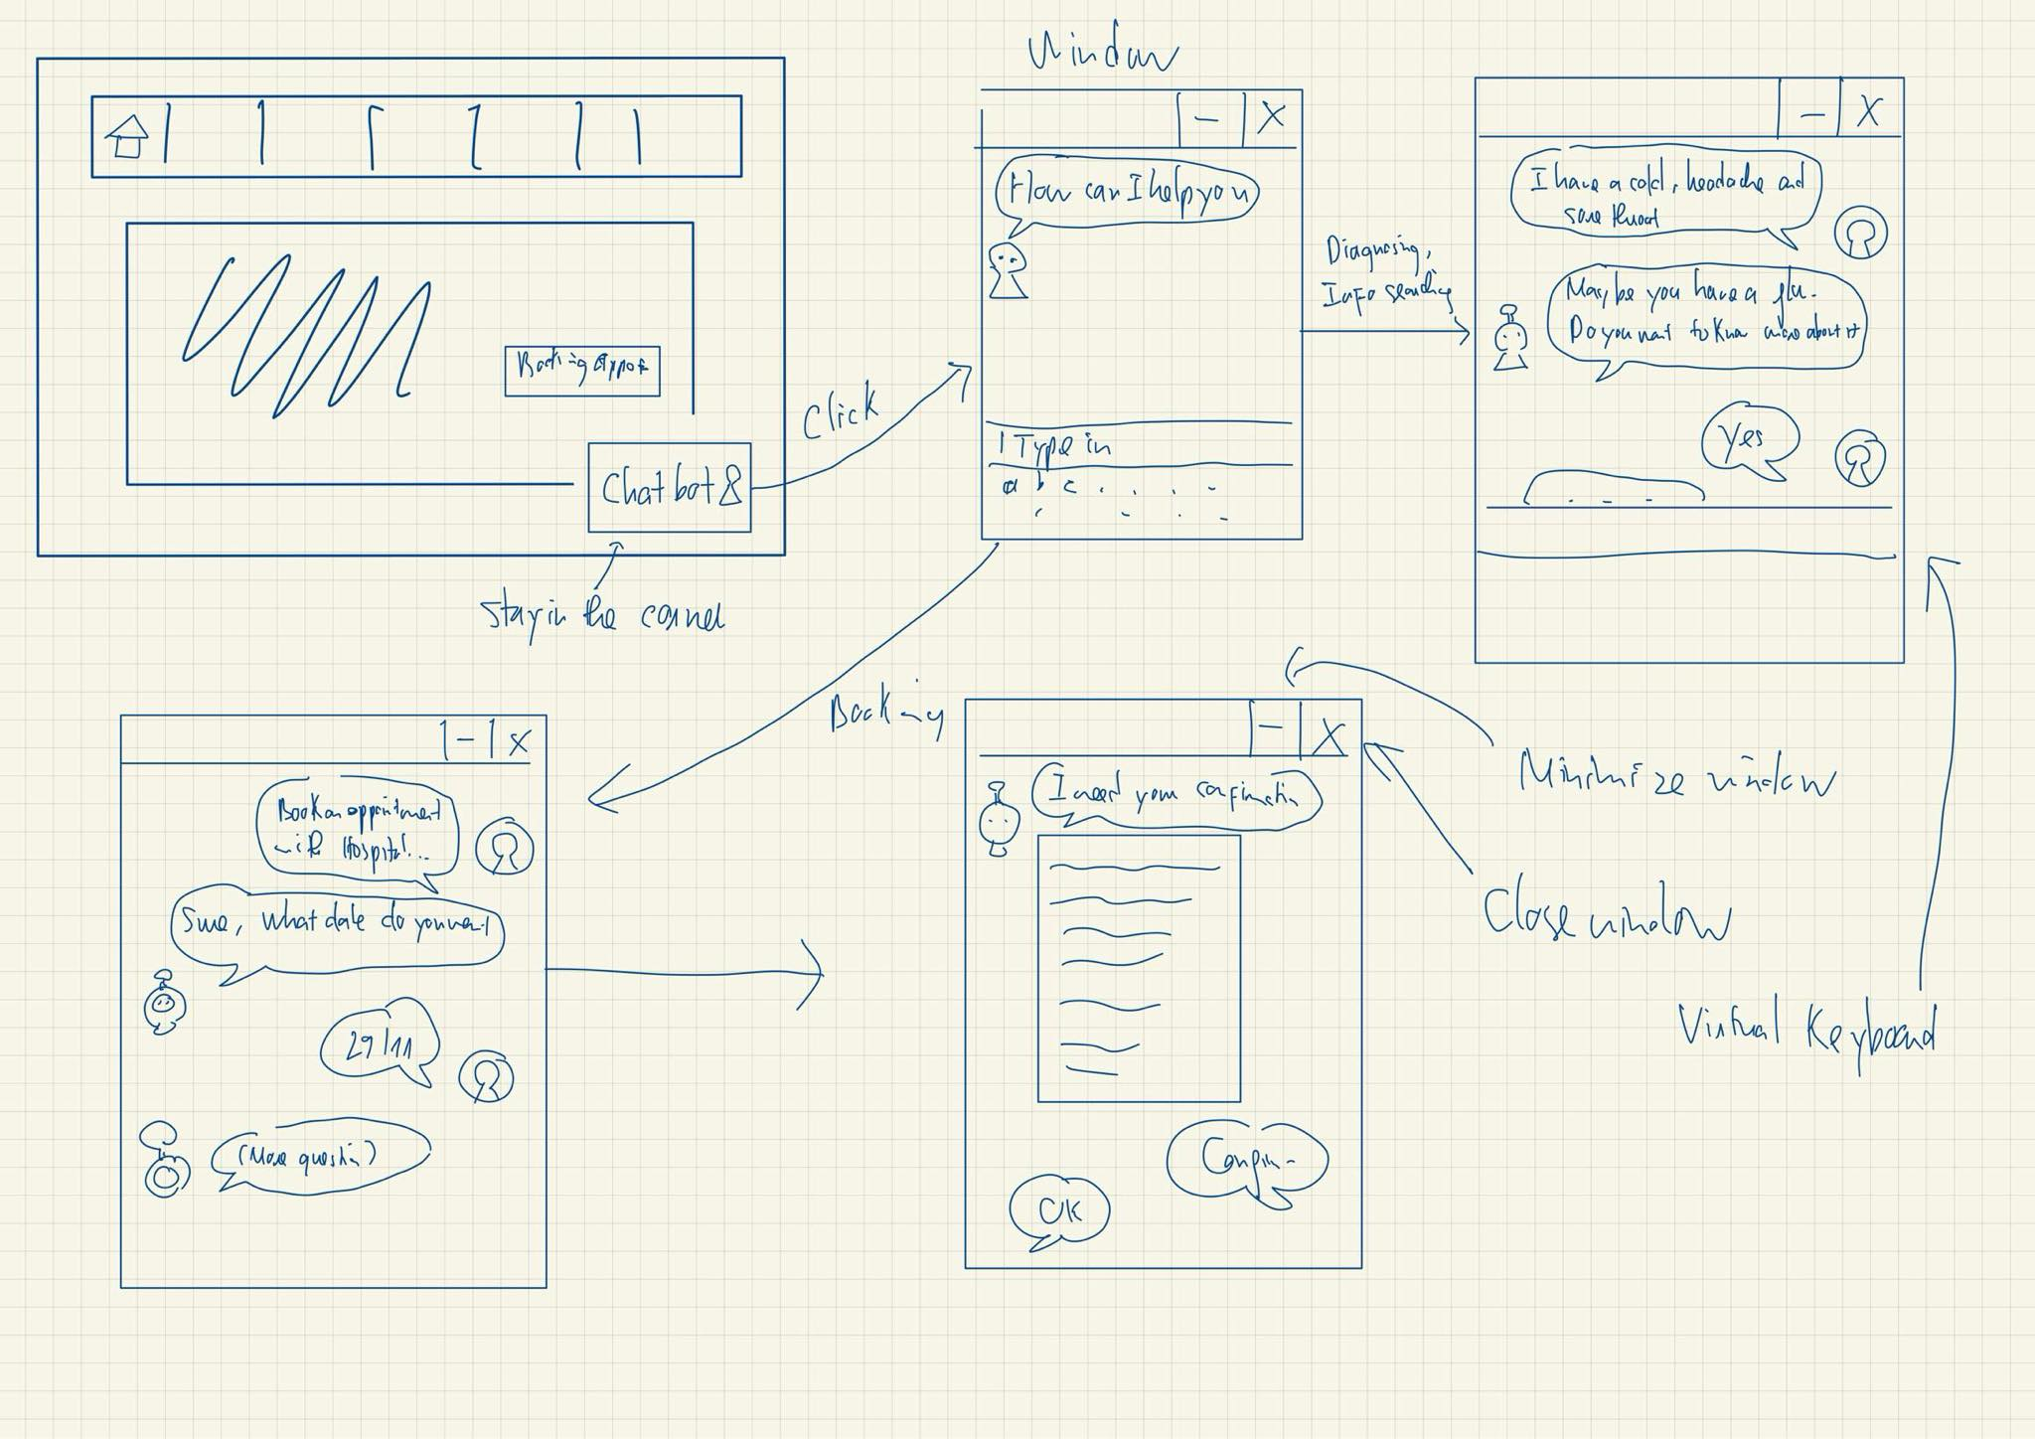
Moderate

Slide 35
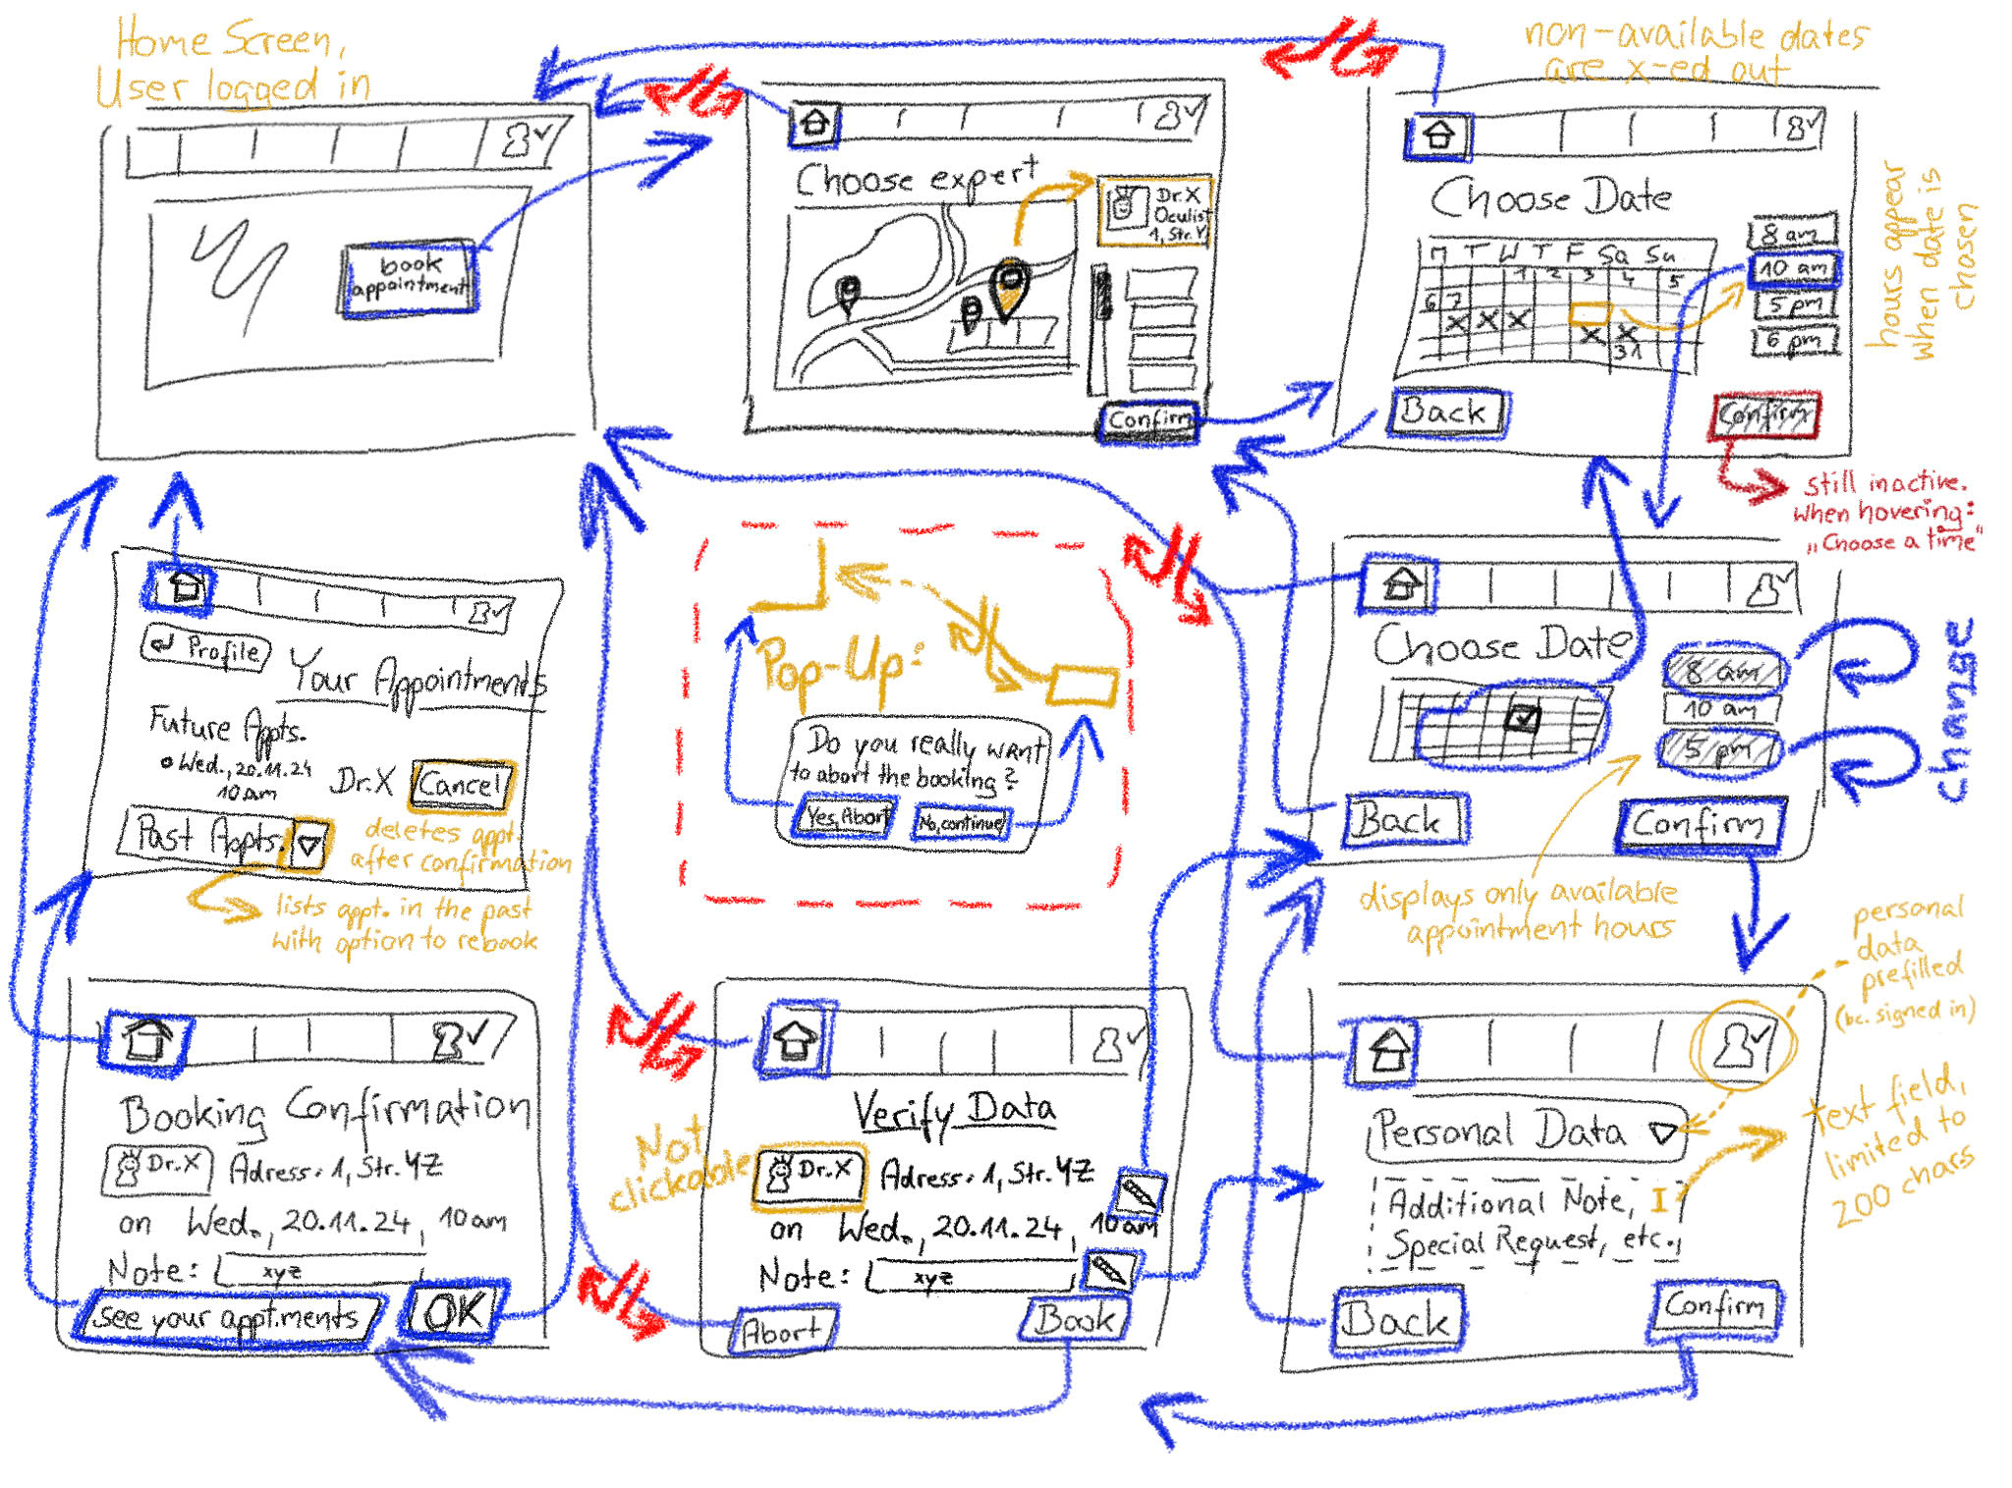
Complex

Slide 36
Testing Methodology

Slide 37
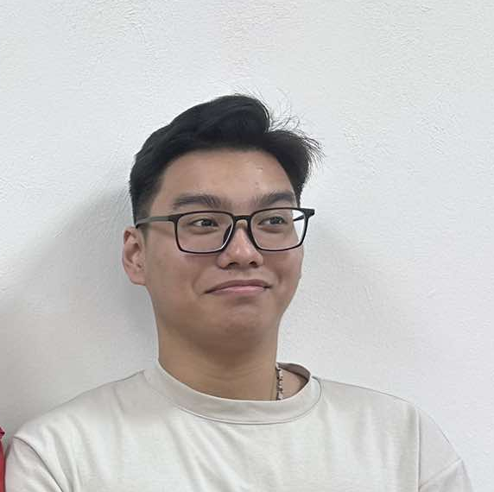


Our interviewees
N. P. Thanh (21)
P. M. Quan (46)
N. L. Na (25)
University student
Extreme user, never use medical website before
Freelancer

Slide 38
Procedure &Process!
We created a paper prototype and manually responded to user actions
Presented hypothetical scenarios to the user, then asked the users to perform the 3 tasks: Booking, Logging in, Chatbot interaction

Slide 39
Procedure &Process!
We took notes of the user behaviors
Participants were asked to think out loud what they do at each step
Participants are asked to give feedbacks about the flow of the prototype, about what they liked/didn’t like.

Slide 40
USABILITY GOALS & KEY MEASUREMENTS
Feature engagement: Use post-interaction surveys to assess user interest in key features (e.g., symptom checker, appointment scheduling) on a scale of 1-10 to gauge their likelihood of regular use.
Intuitive navigation: Track the number of navigation errors (e.g., misclicks or unintended page visits) users make while completing tasks such as booking an appointment or accessing health records.

Slide 41
Process Data
All 3 participants:
Found the appointment booking interface difficult to navigate.
Desired better integration with external calendars for scheduling.
Have no trouble interacting with the chatbot
2 participants:
Wanted the ability to customize their dashboard layout.
Want Third party Login, or F2P authentication
1 participant:
Got lost in the booking

Slide 42
Other observations
Task 1 (login): Caused a few "mis-clicks" due to unclear button labeling.
Task 2 (booking an appointment): Required the most time and multiple steps, indicating inefficiencies.
Task 3 (chatbot): Easy for users with minimal navigation effort.

Slide 43
05
Med-fidelity Prototype

Slide 44
Revised Interface

Slide 45
Low-fi
Simple but boring
Major design change #1
How should we make the login/sign up interface more intuitive

Slide 46
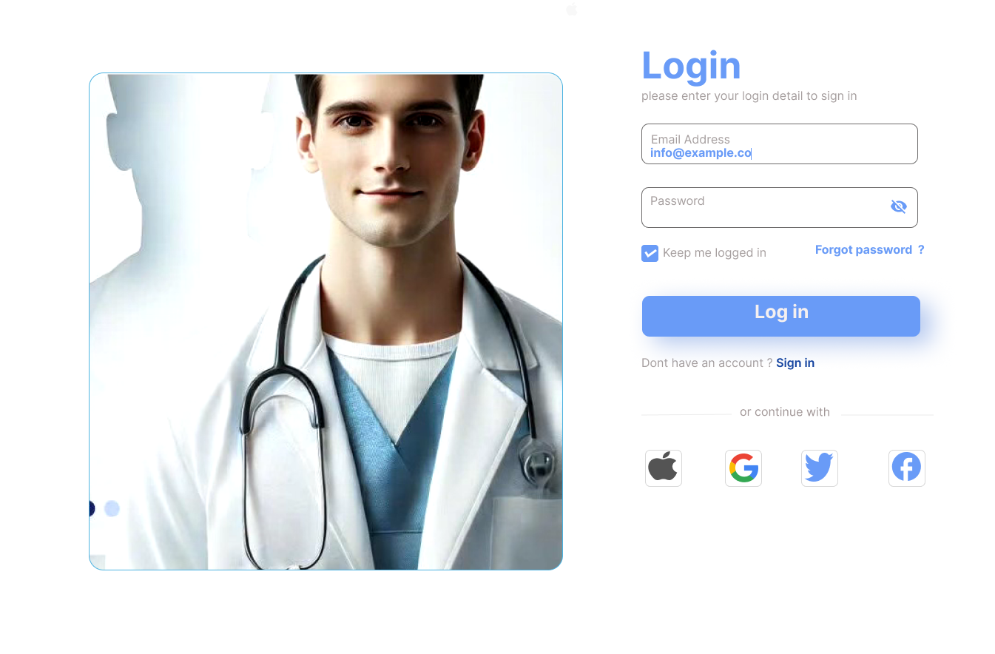
Feedback
“The interface is a bit simple”
Change
Add an image for better visual
Add third party sign in
Rationale
Lowfi was boring to view, so we enhance the visual by adding image
We want to make the website more accessible, so add some other options for sign in

Slide 47
Low-fi
Chatbot
Design change #2
How should we make the chatbot easier to use, especially for the elderly

Slide 48
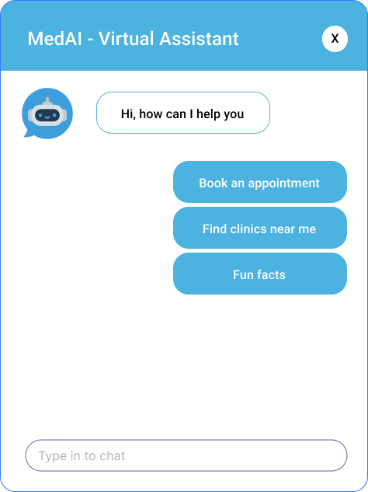
Feedback
“Old people may not know how to use the chatbot”
Change
Add predefined suggestions option
Rationale
Add some options for the tasks that the website provide, like appointment or finding clinic

Slide 49
Low-fi
Too complex, clustered
Design change #3
How should we simplify the appointment booking flow for easier usage

Slide 50
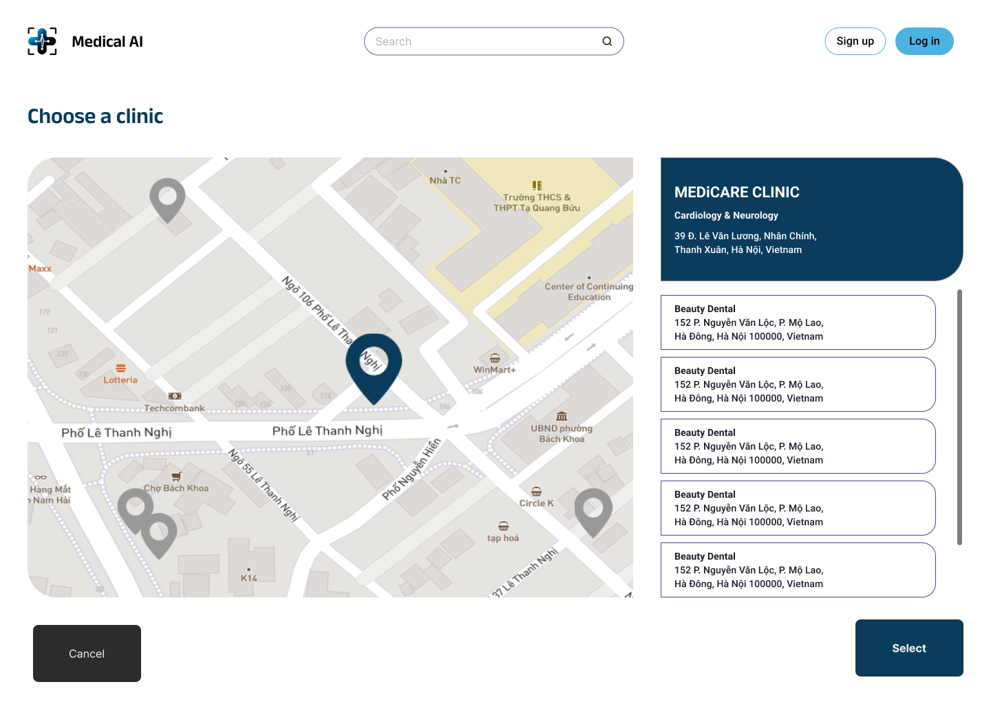
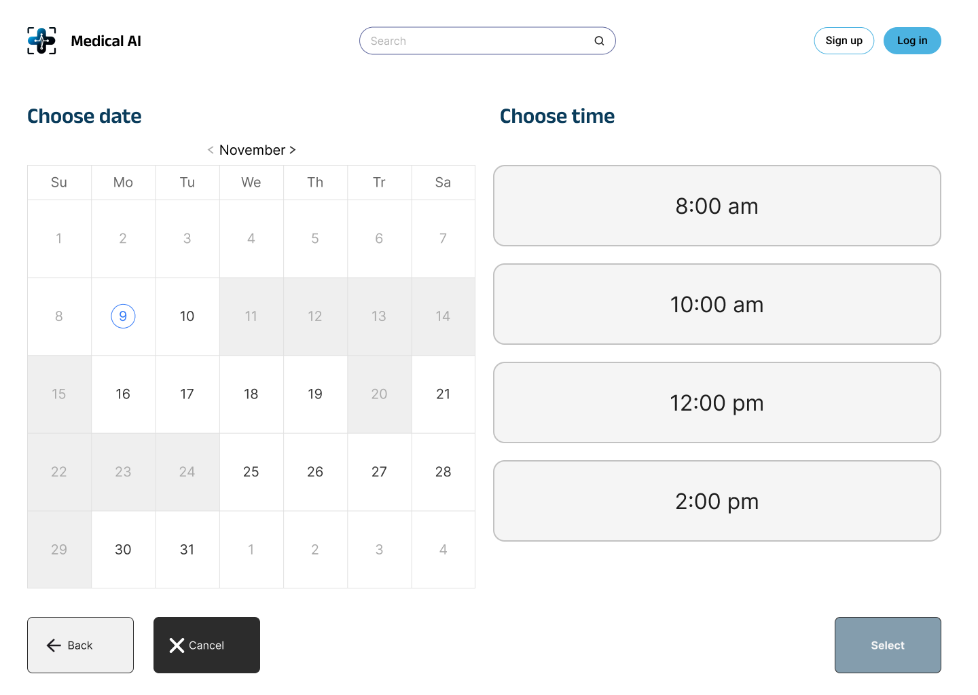
Feedback
“The process seems too complicated”
Change
Reduce information bloat, keep it short but sufficient
Reduce the number of screens user has to go through
Rationale
We defined the major steps in the booking process to keep it simple for the user

Slide 51
03
Tasks flow

Slide 52
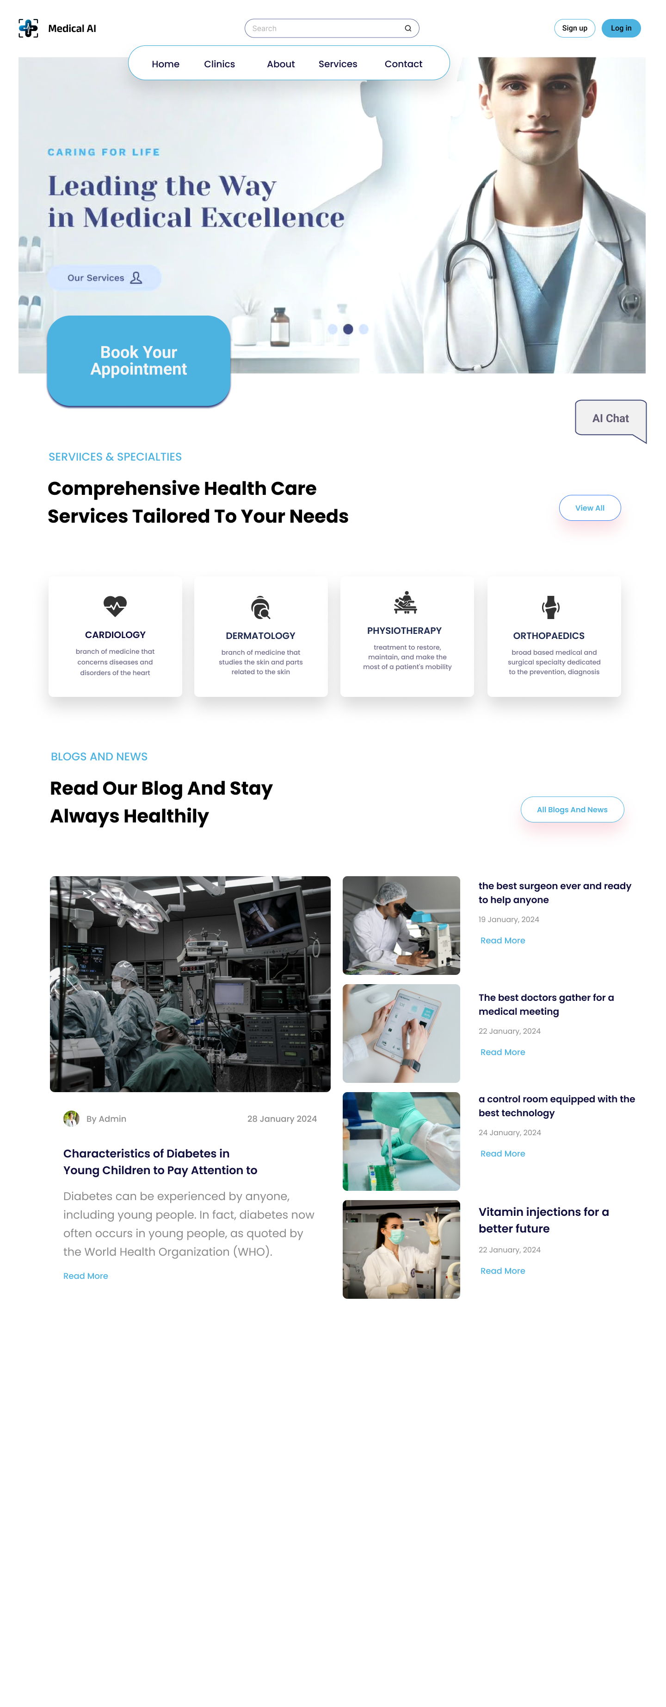
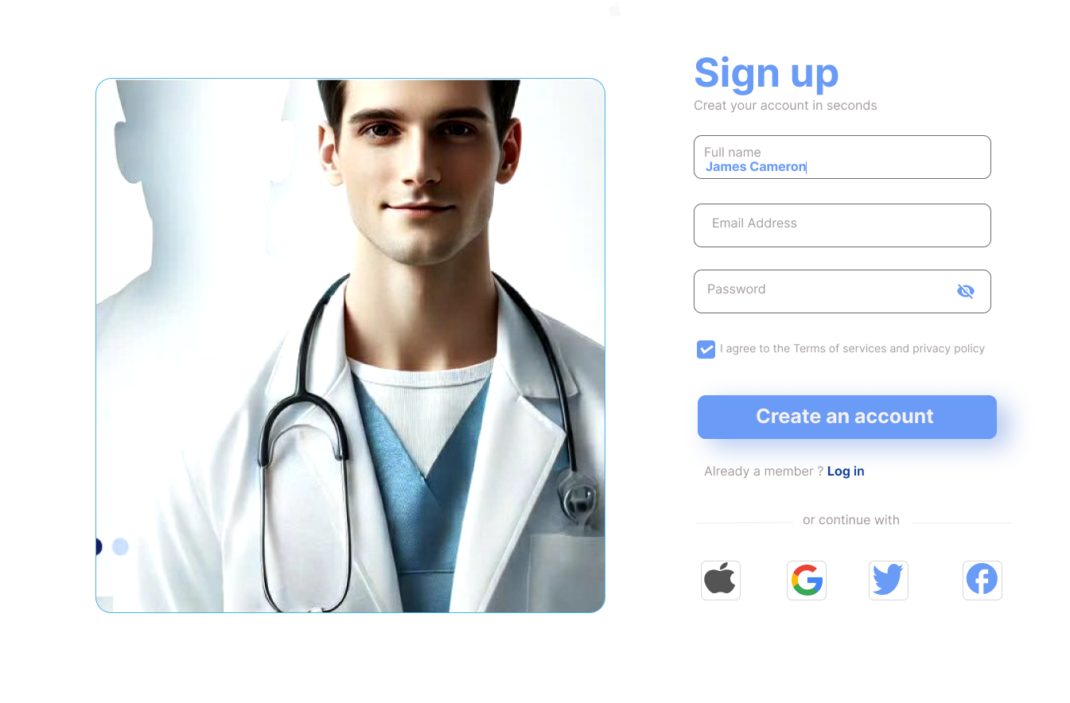





Simple
Login/ Sign Up
Click the Login/ Signup button to change to that screen
Confirm to go back the main screen

Slide 53


Moderate
Chatbot Part 1
Close the window
Click the button to open the Chat window

Slide 54
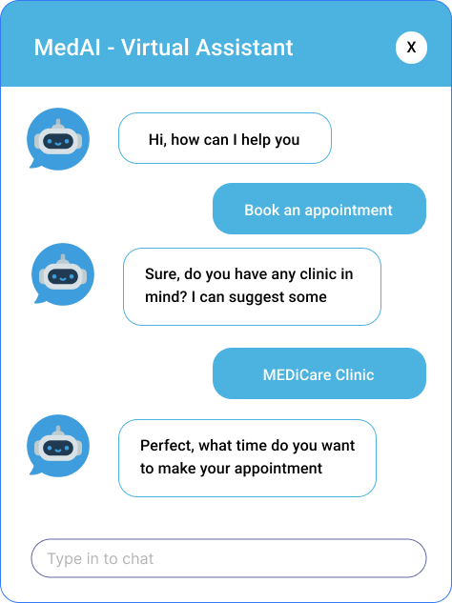
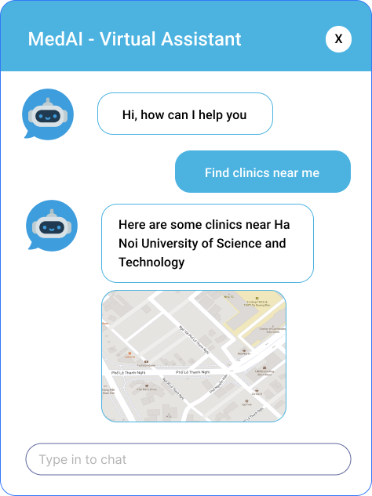
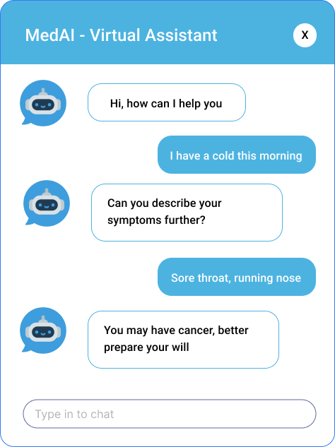


Moderate
Chatbot Part 2
Choose the Predefined option to continue with that conversation
Type in chat to create custom chat

Slide 55

Complex
Appointment booking Part 1
Click the Button to open the Booking Screen
Cancel to go back

Slide 56

Complex
Appointment booking Part 2
Choose a clinic
Choose a time and date
Click Select to choose the date
Back to go back

Slide 57
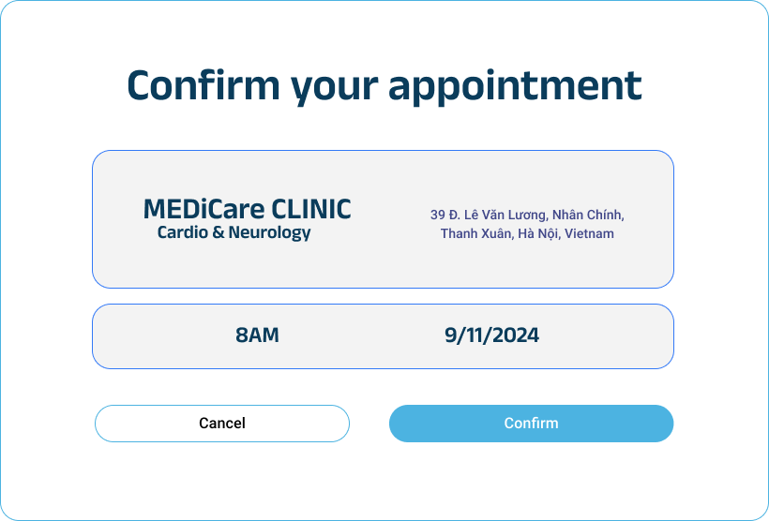
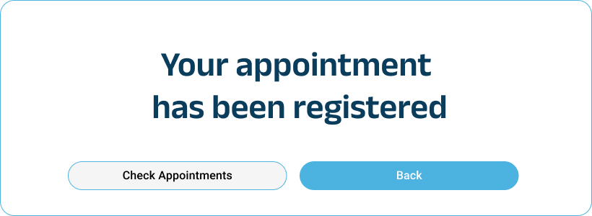
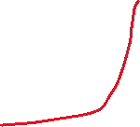
Complex
Appointment booking Part 3
Cancel to go back
Confirm to show the confirmation message
Select to confirm
Go back to the home screen

Slide 58
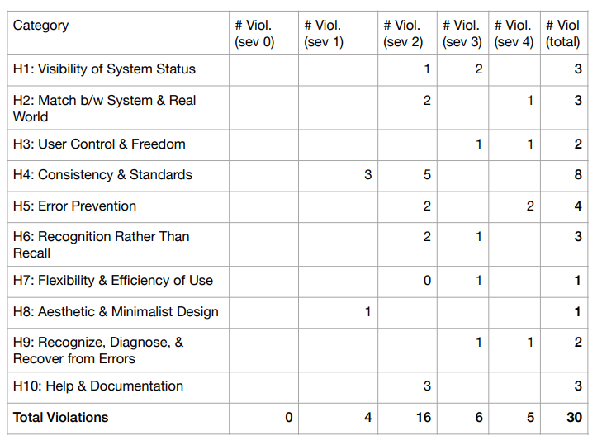
Heuristic Evaluation Summary

Slide 59
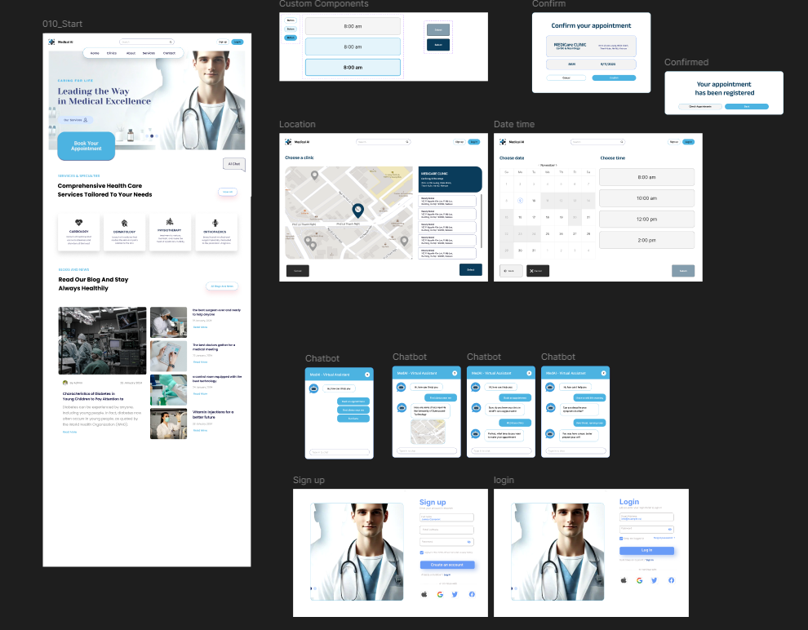
Final MedFi Result: Link

Slide 60
Thanks!

